Slide 1
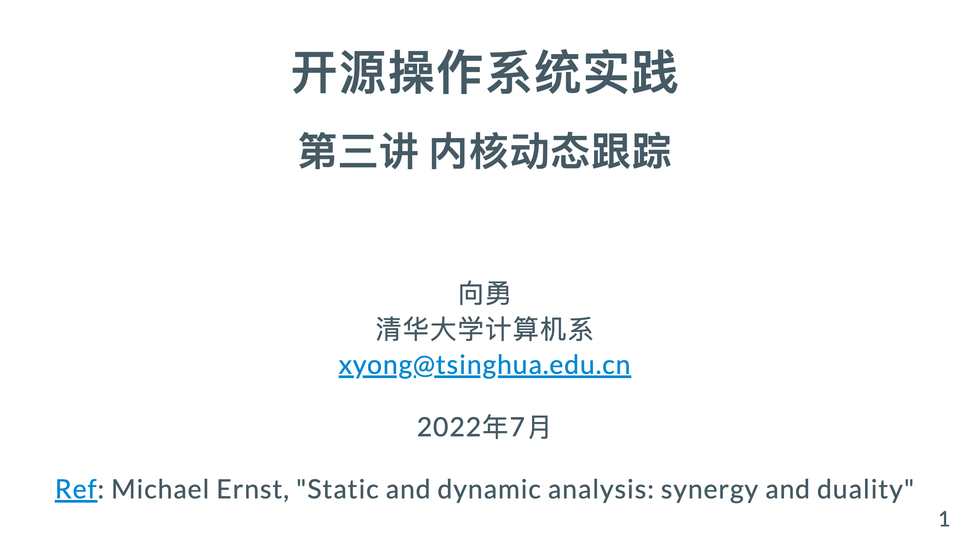

Slide 2
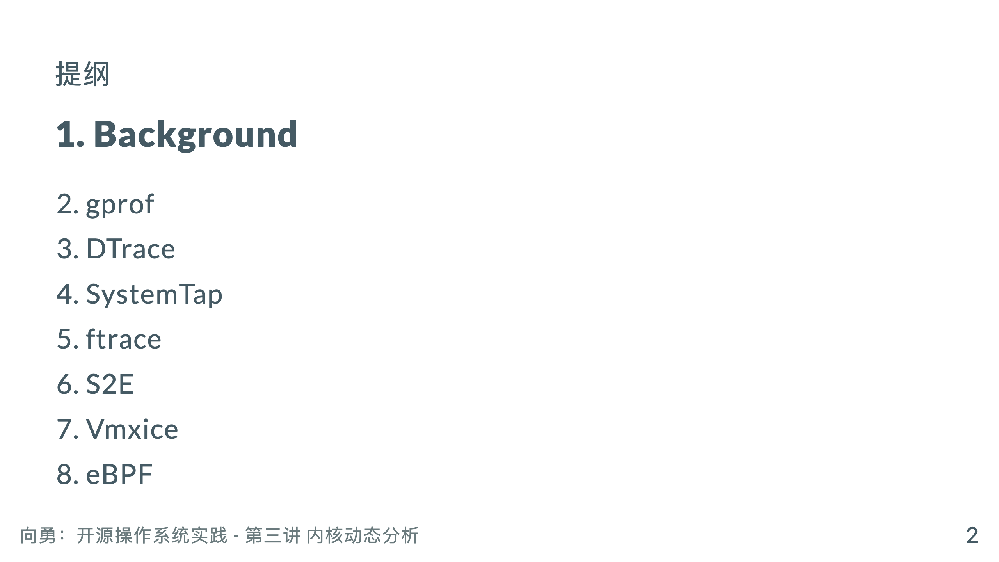

Slide 3
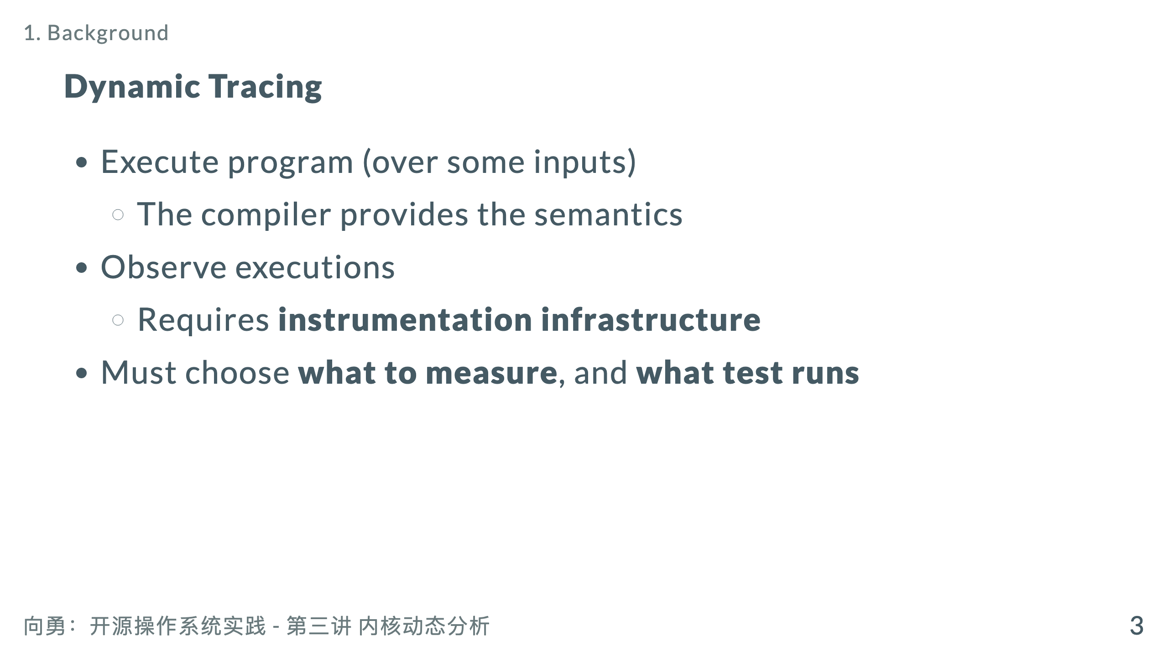

Slide 4
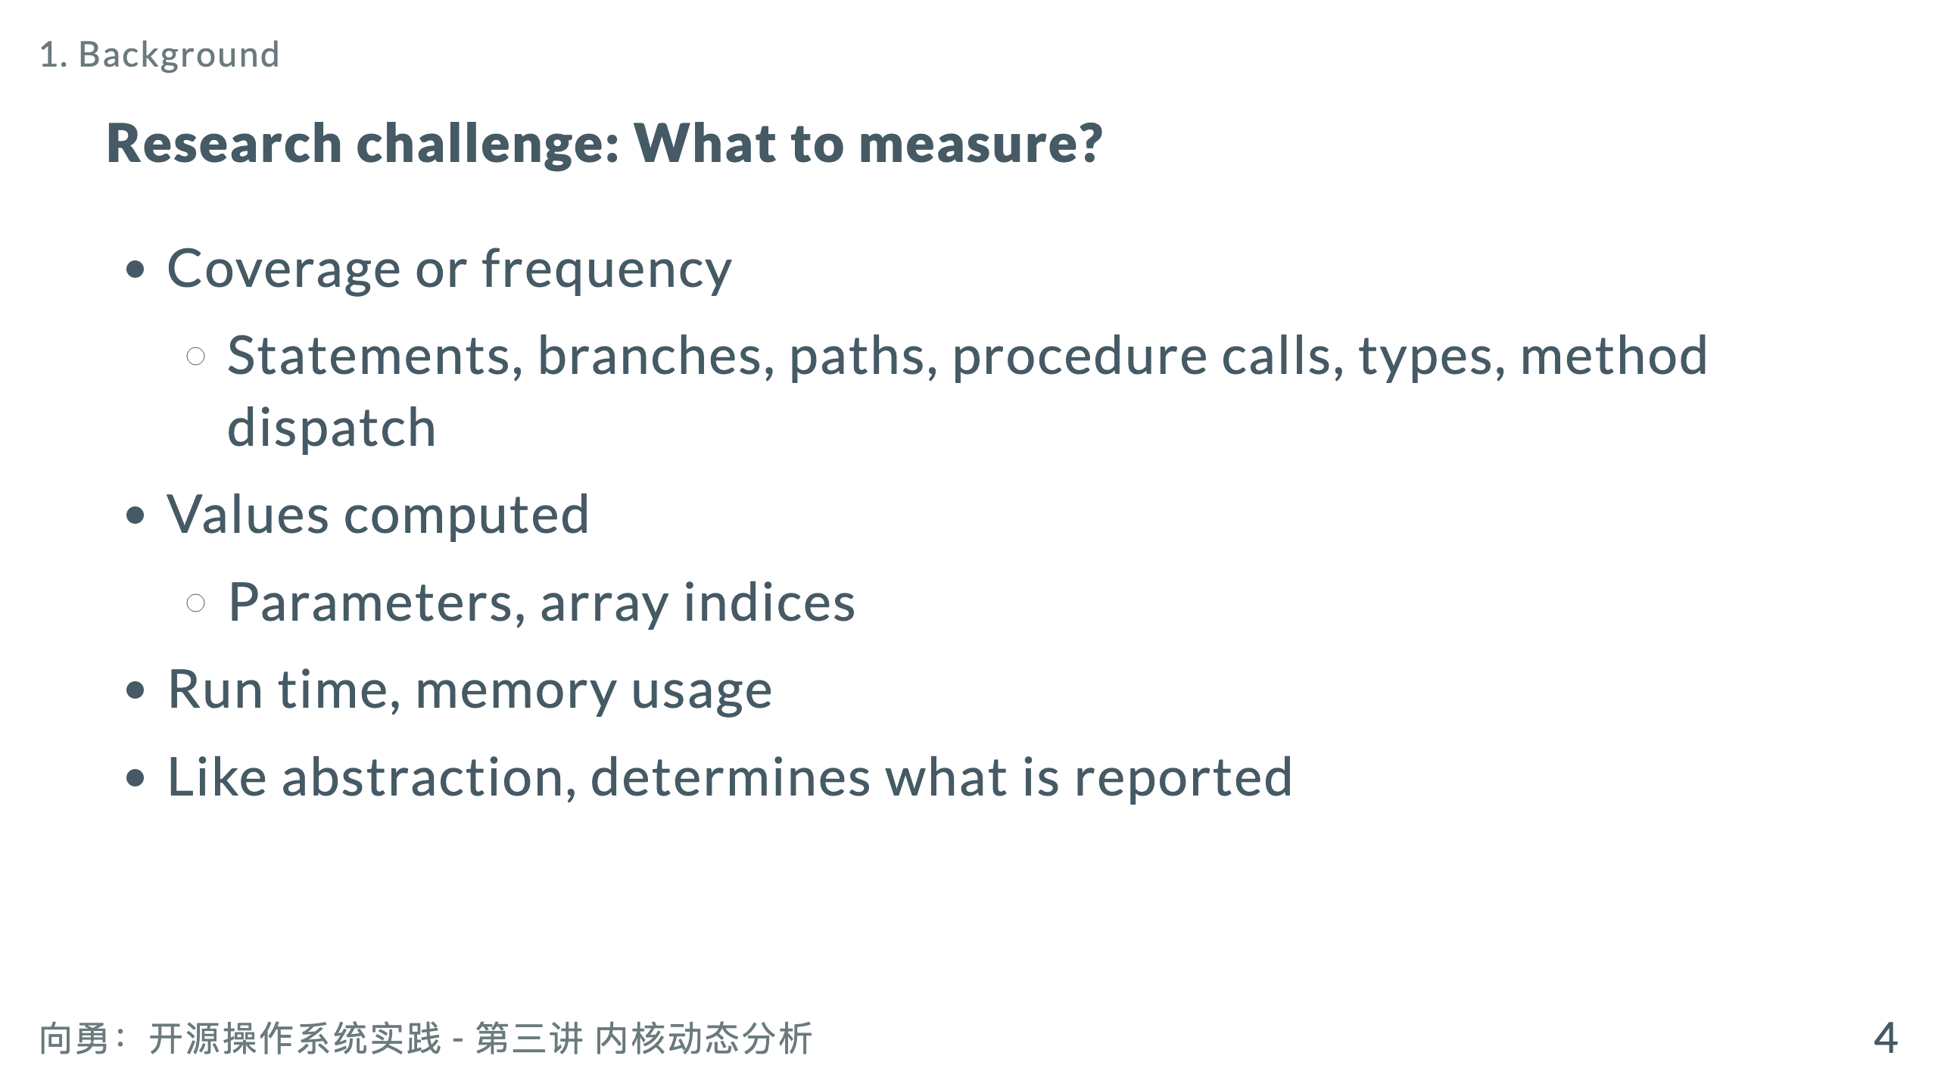

Slide 5
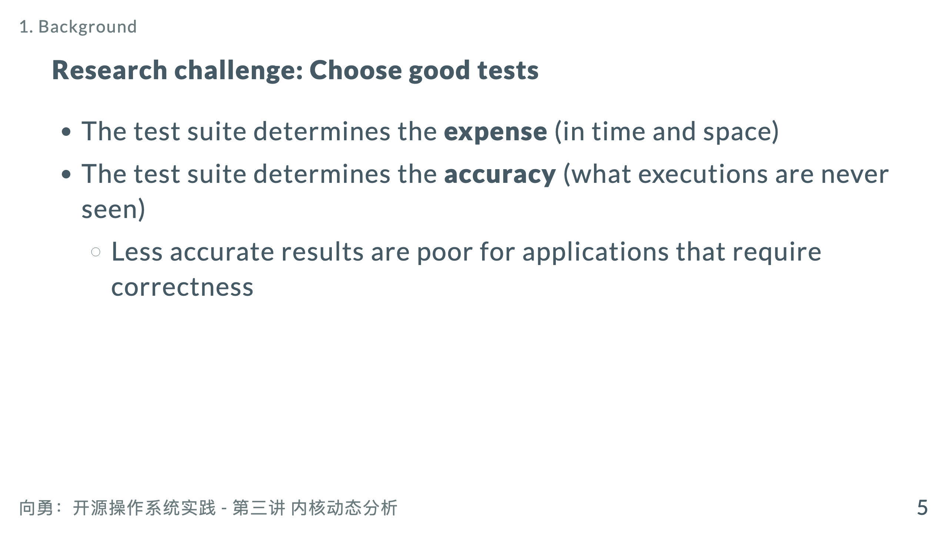

Slide 6
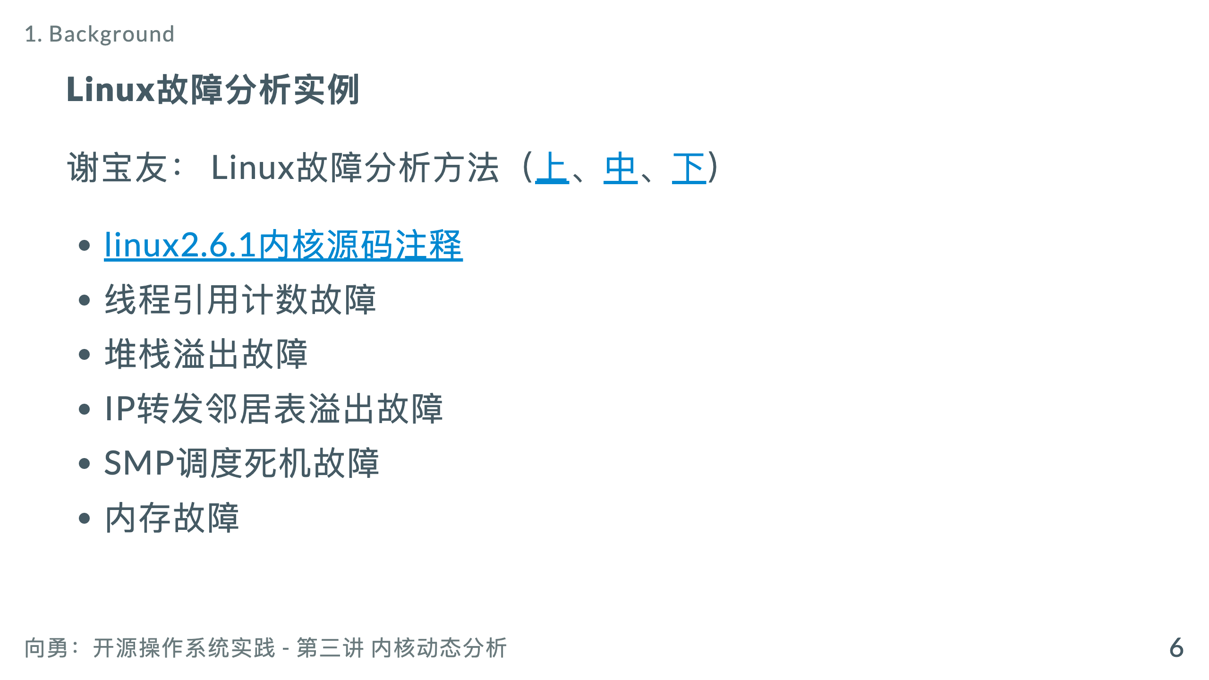

Slide 7
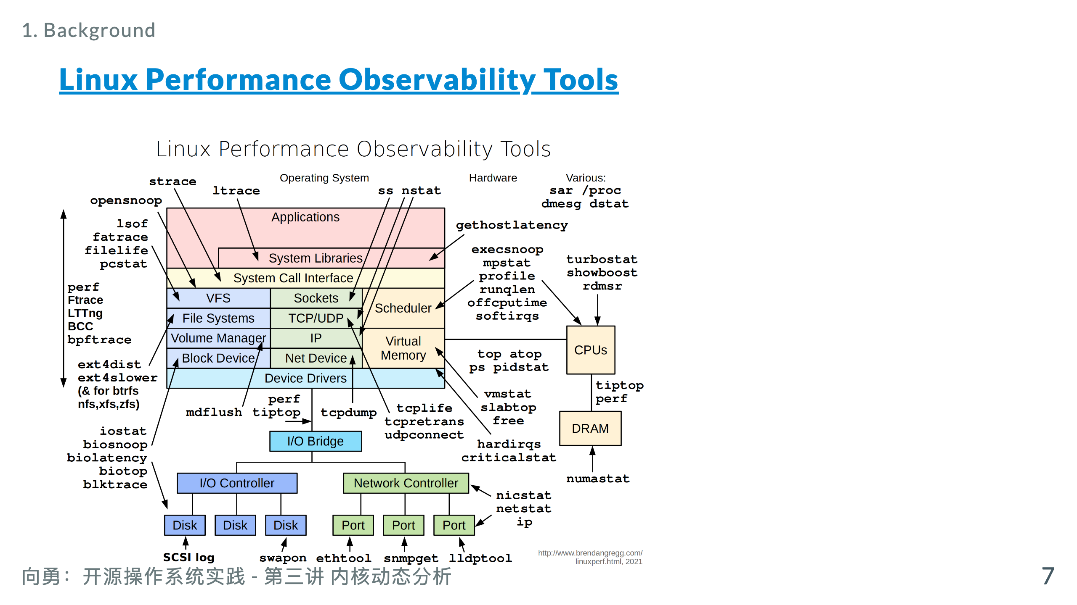
Notes:
https://www.brendangregg.com/Perf/linux_observability_tools.png http://www.brendangregg.com/linuxperf.html

Slide 8

主观题
1分
假定你自己写的一个程序，运行结果与预期不一致。请问，你如何进行故障定位？
作答

Slide 9
主观题
1分
在故障定位的过程中，你遇到的最大困难是什么？
作答

Slide 10
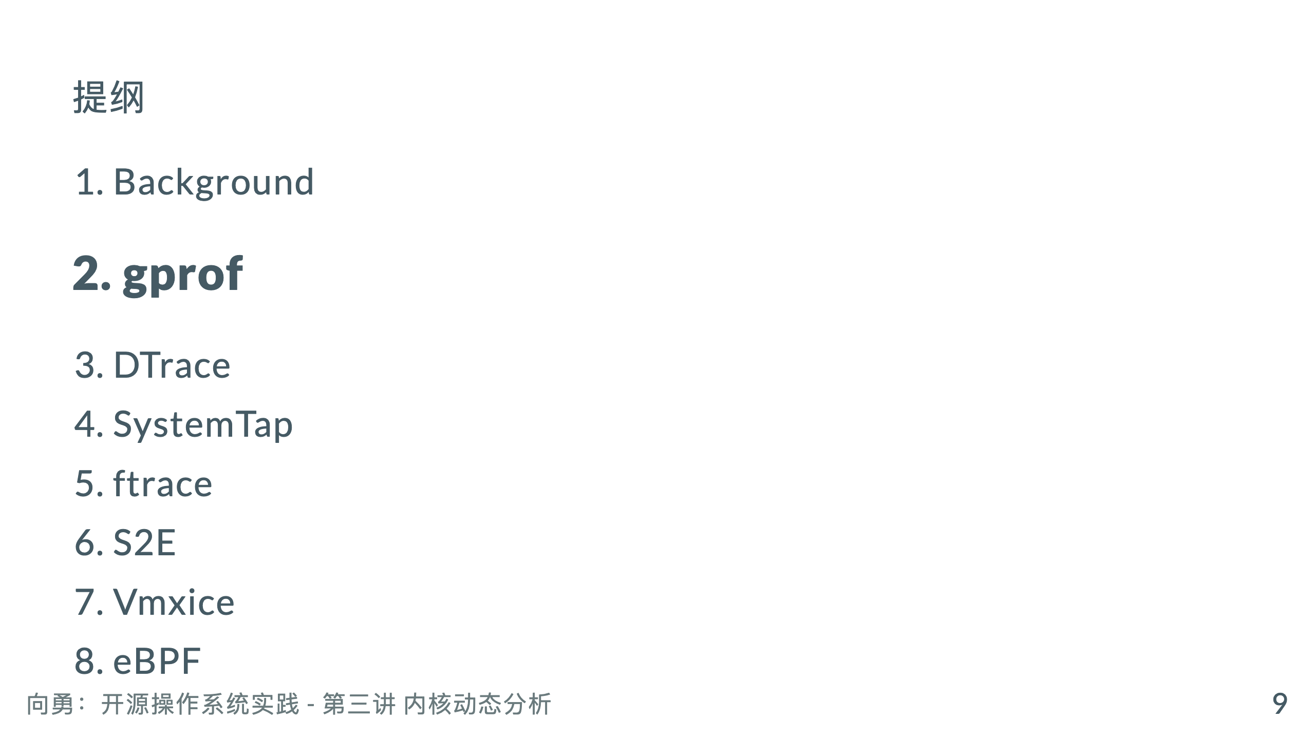

Slide 11
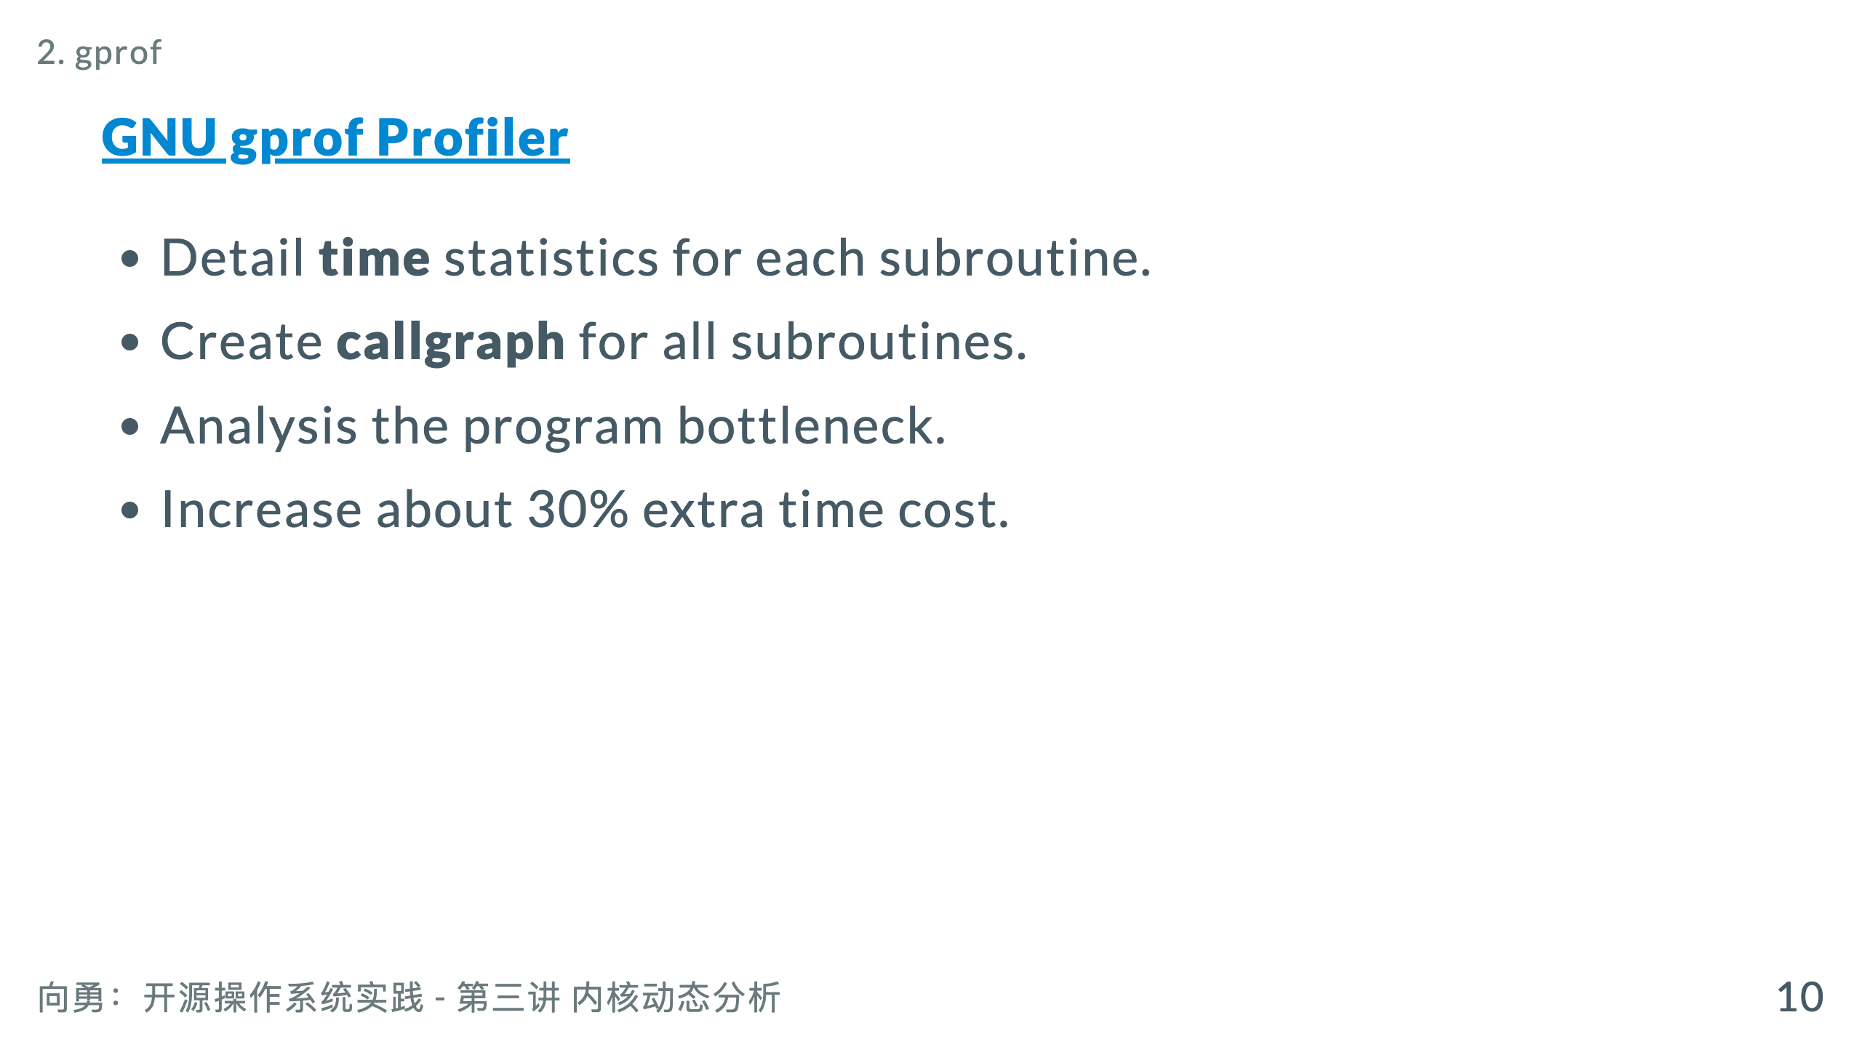
Notes:
Profile noun 1 an outline of something, esp. a person's face, as seen from one

Slide 12
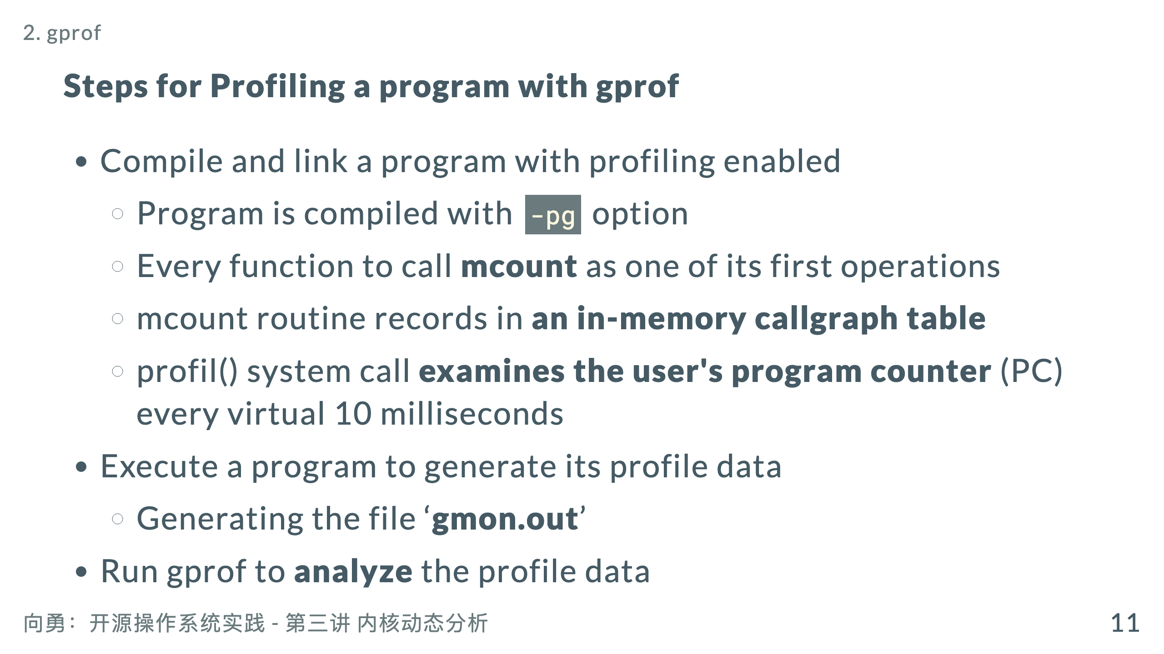
Notes:
* gprof’s symbol table, an array of Sym structures, is built

Slide 13
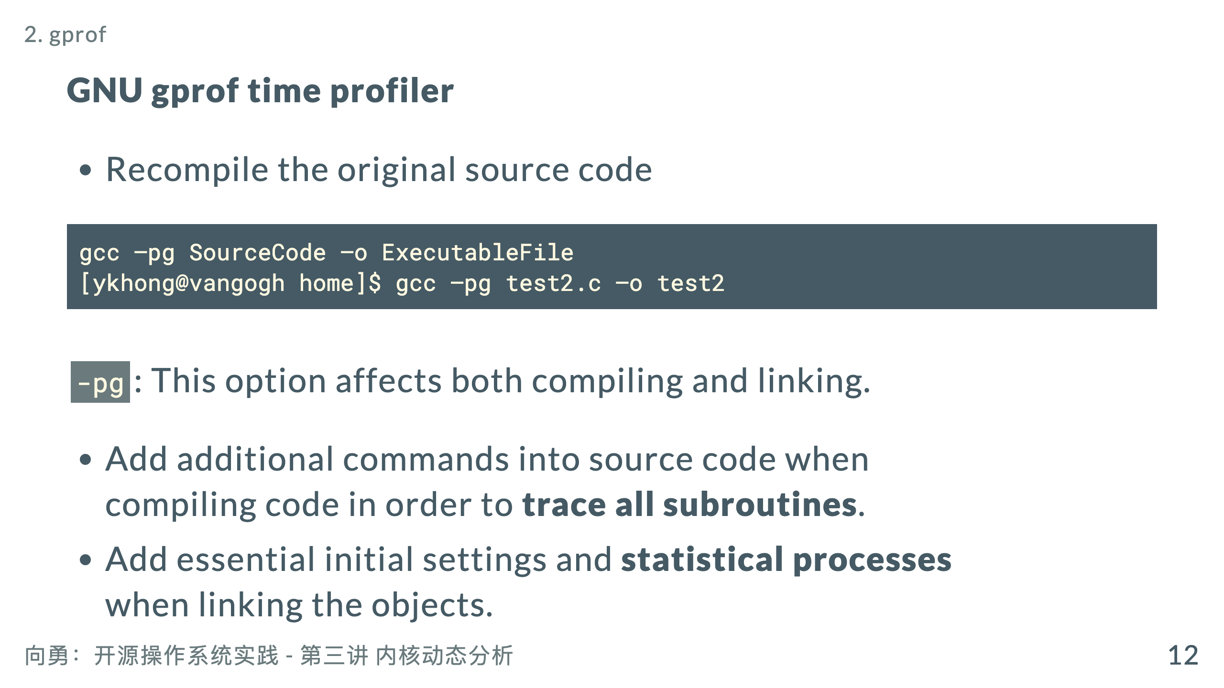

Slide 14
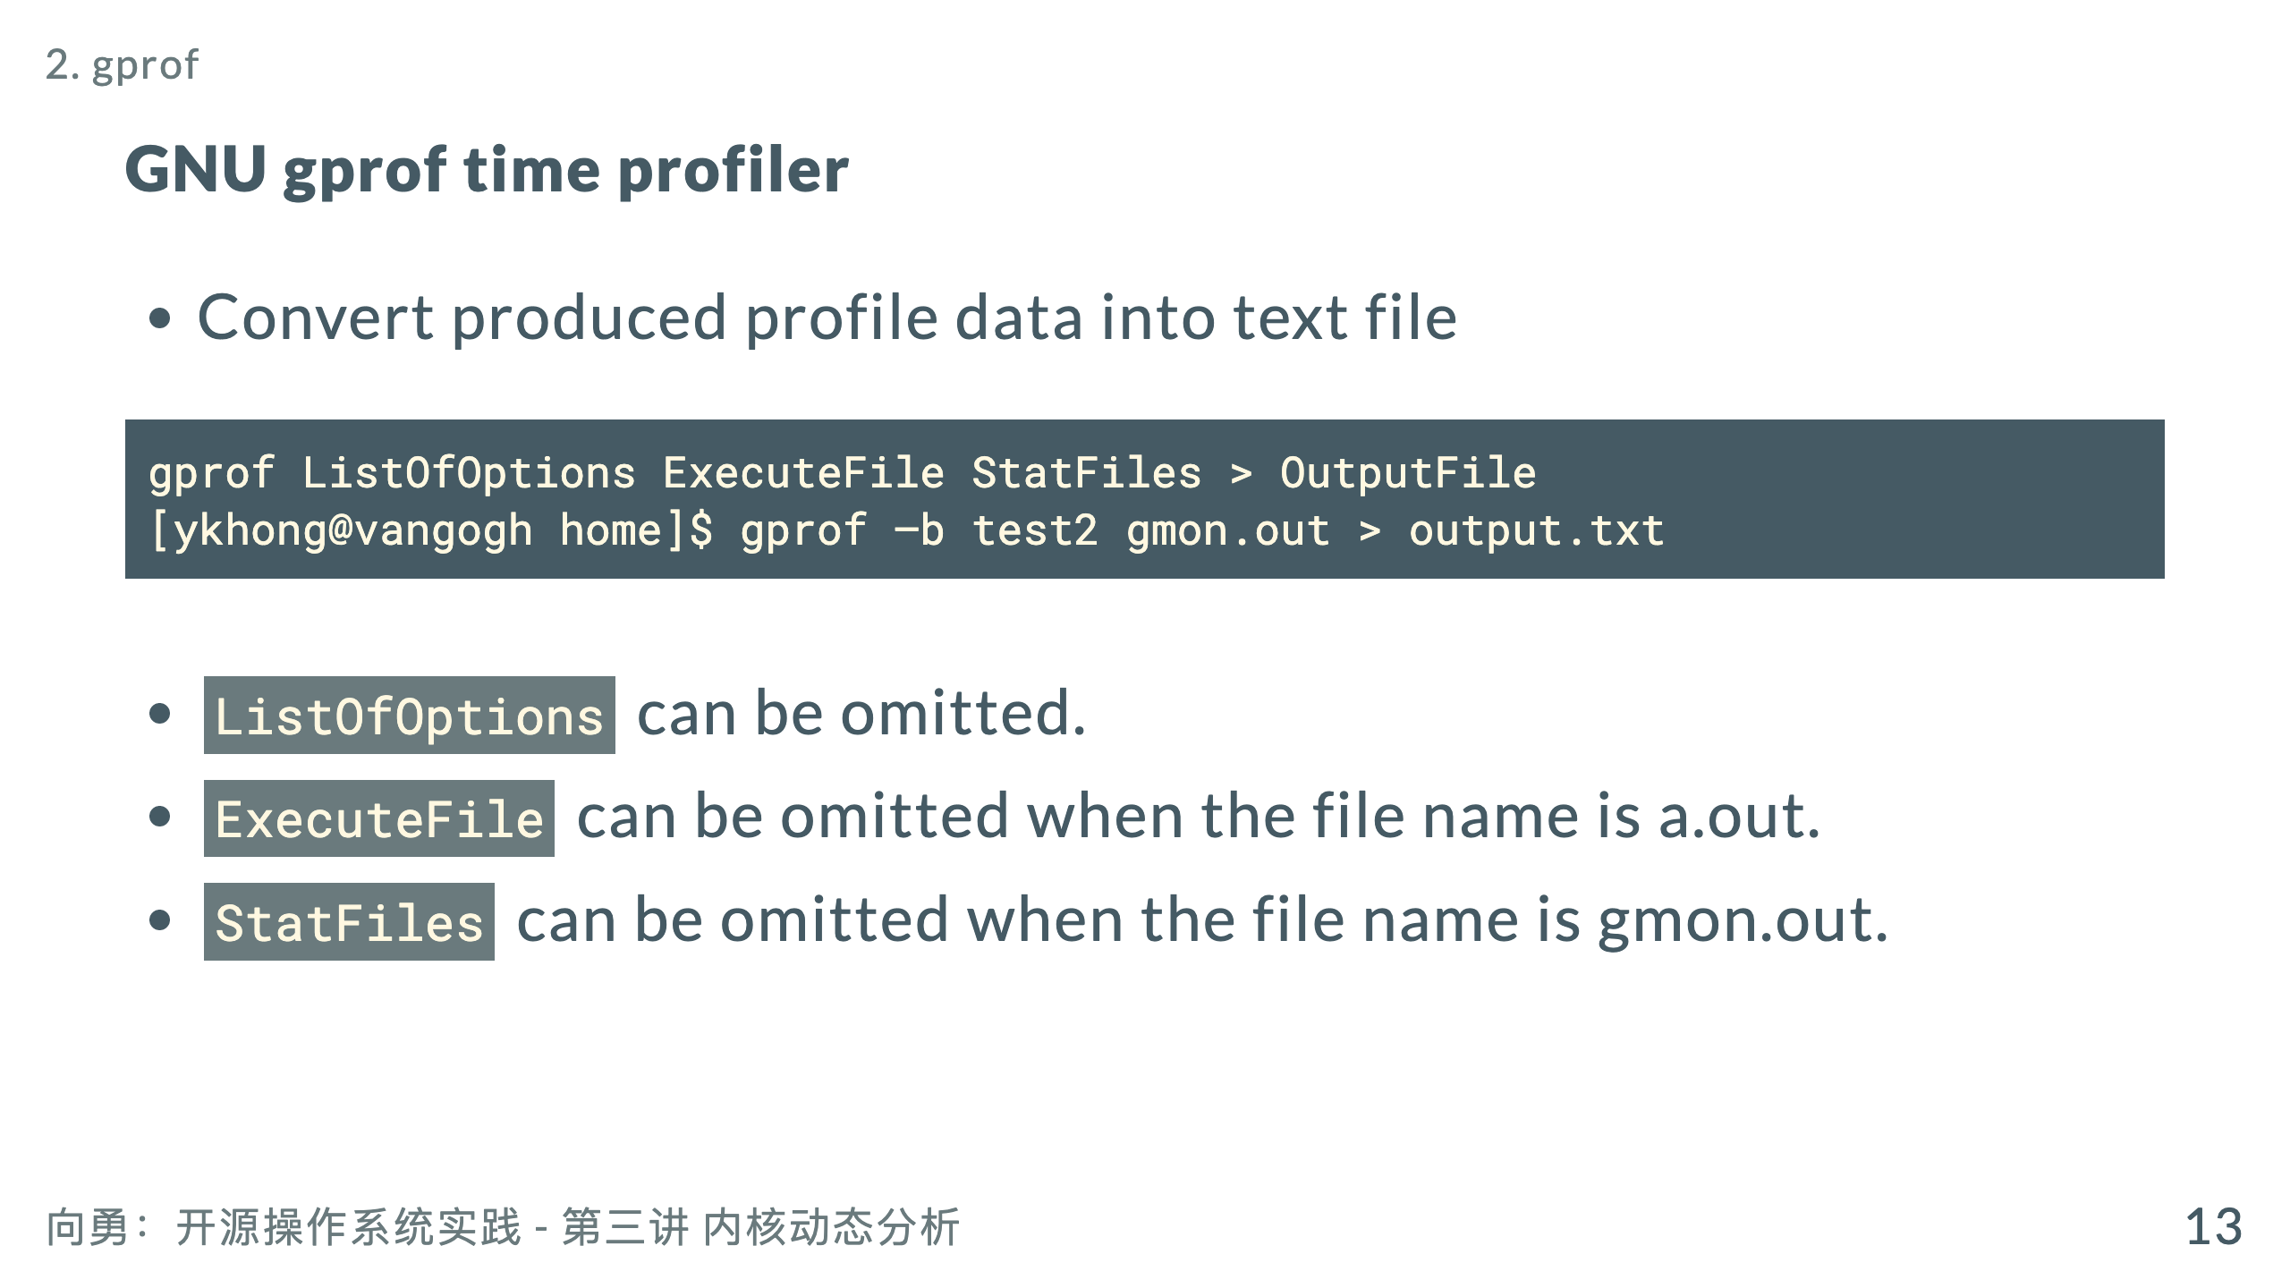

Slide 15
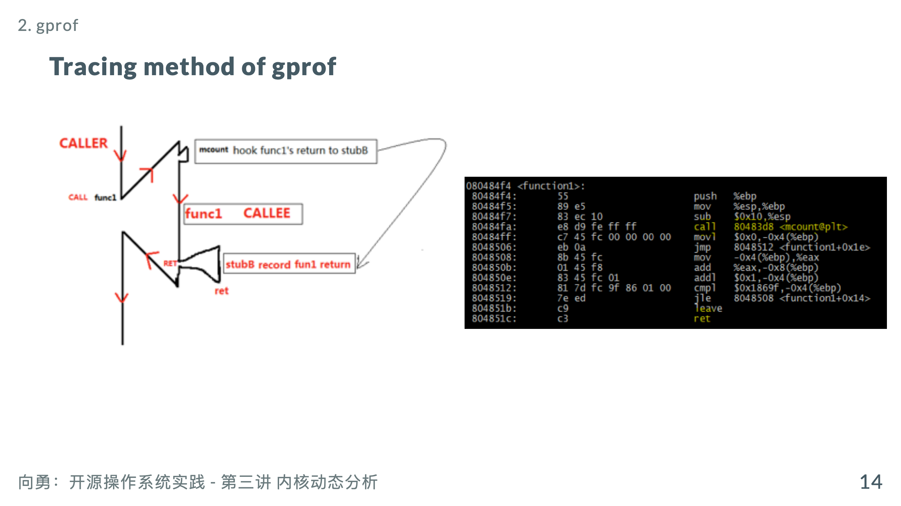
Notes:
http://os.cs.tsinghua.edu.cn/hgj/Interface/analysis/PaperList#head-4f9d1b3fa37f96cf79230e31ee571c85c14839ff 基于硬件虚拟化的内核动态追踪系统

Slide 16
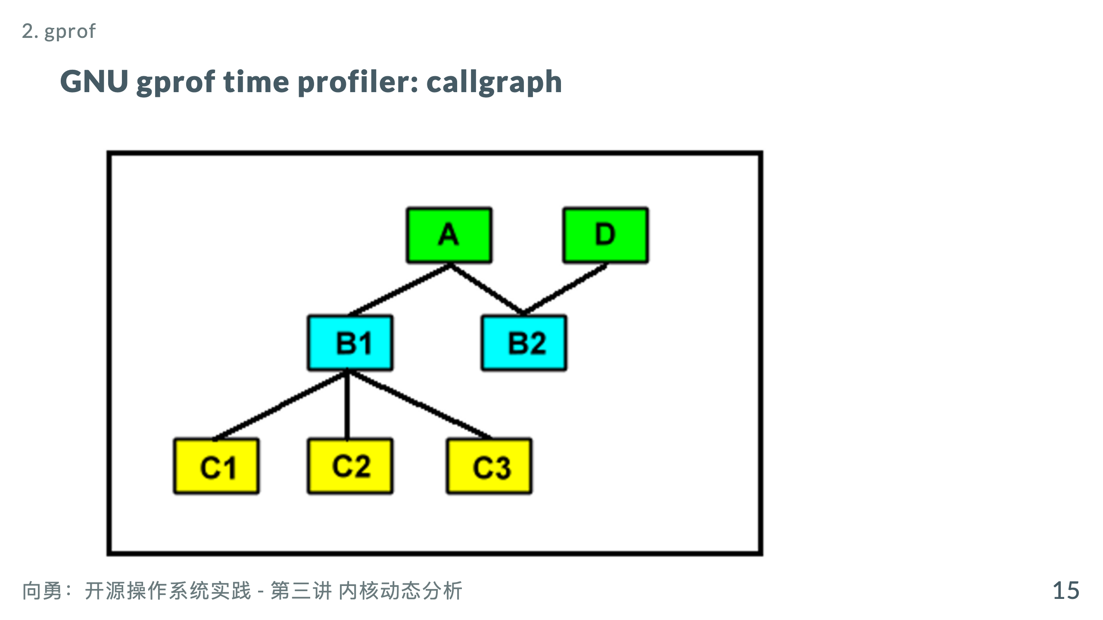

Slide 17
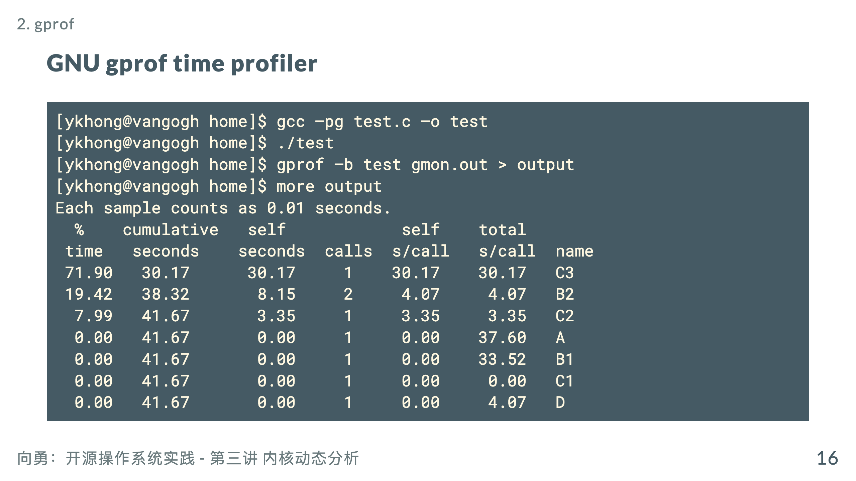
Notes:
% time: the percent of self seconds from total program elapsed time. cumulative seconds: the seconds cumulate from self seconds. self seconds: total elapsed time called by its parents, not including its children’s elapsed time. equal to (self s/call)*(calls) calls: total number for each subroutine called by its parents. self s/call: elapsed time for each time called by its parents, not including its children’s elapsed time. total s/call: total elapsed time called by its parents, including its children’s elapsed time. name: subroutine name.

Slide 18
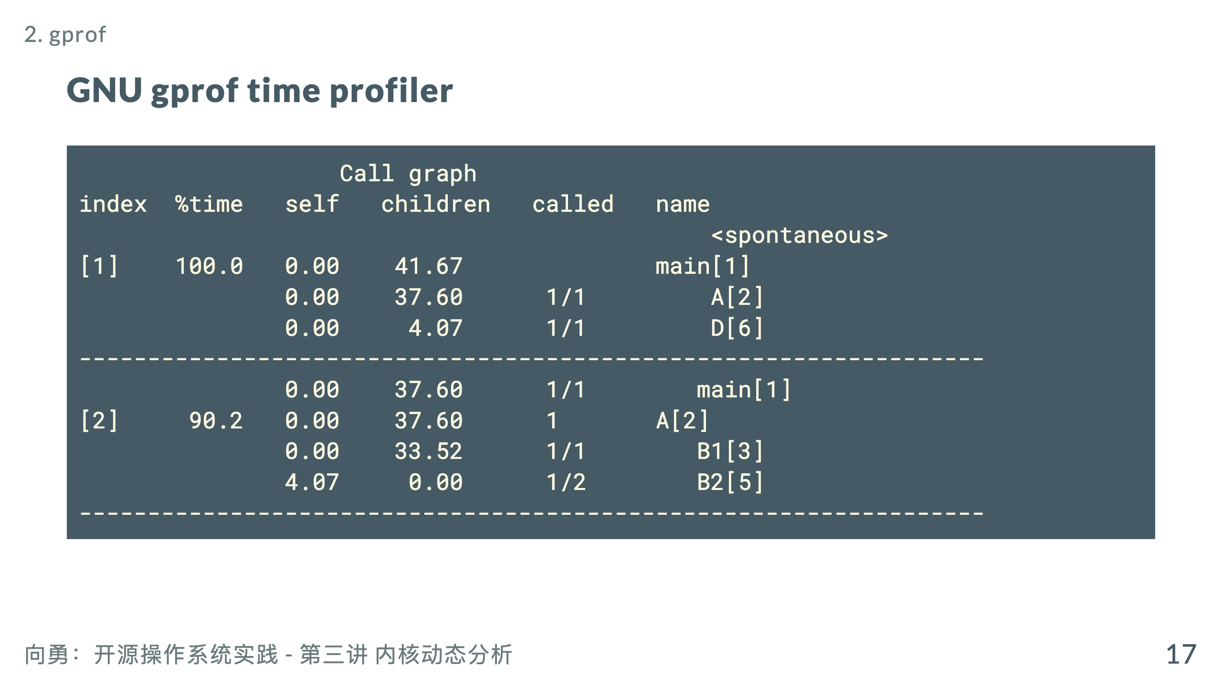

Slide 19
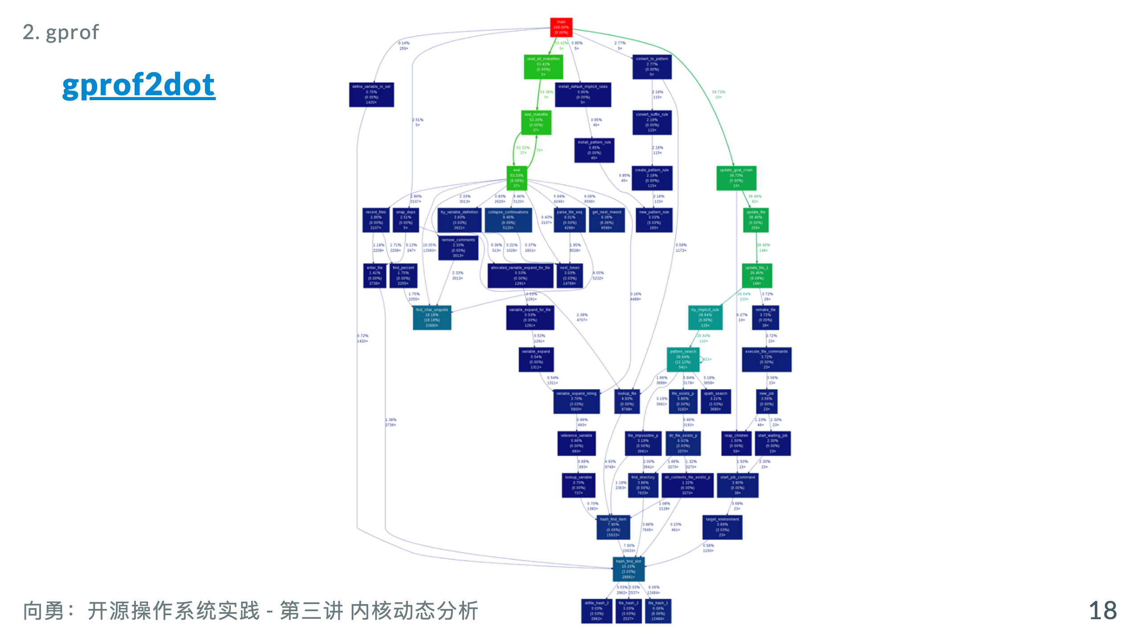
Notes:
https://github.com/jrfonseca/gprof2dot

Slide 20
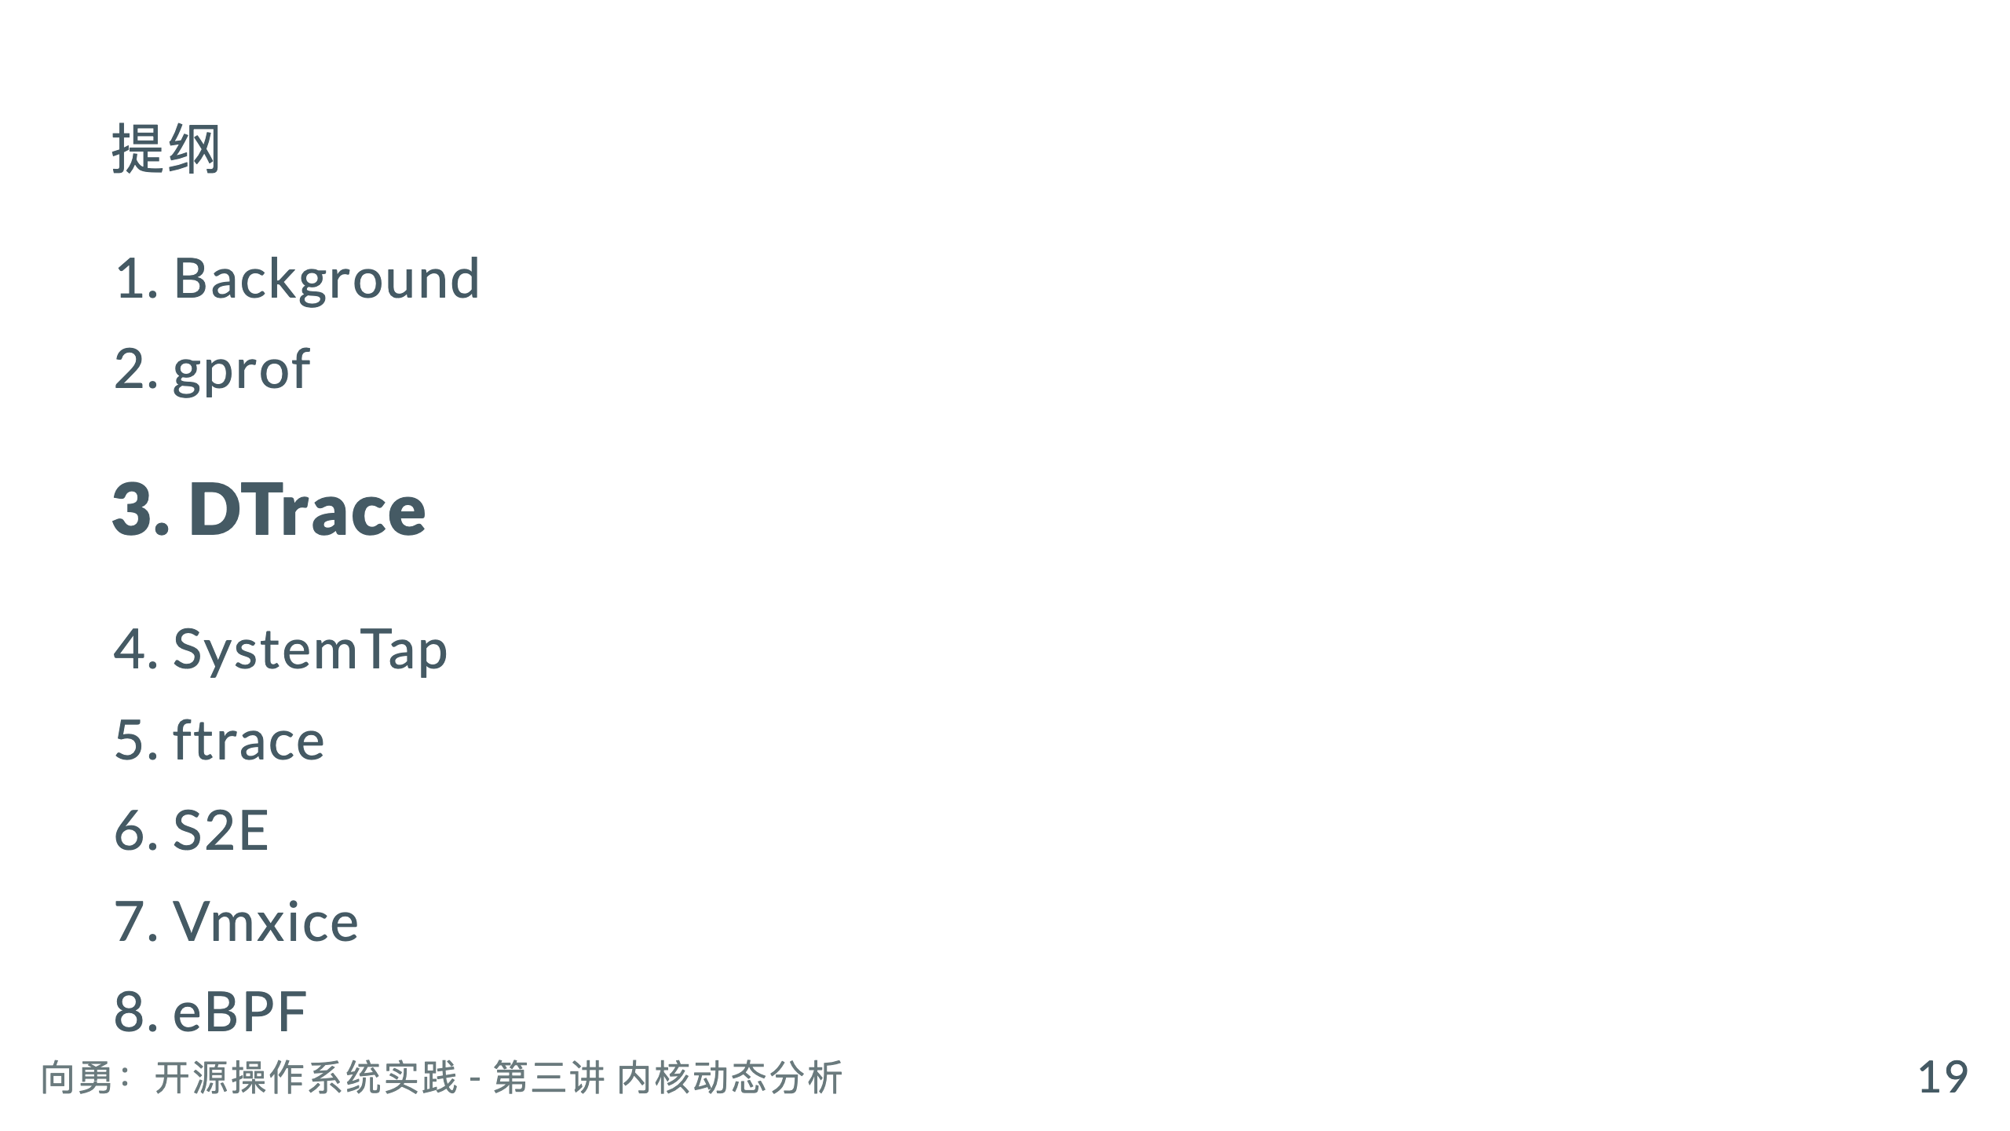

Slide 21
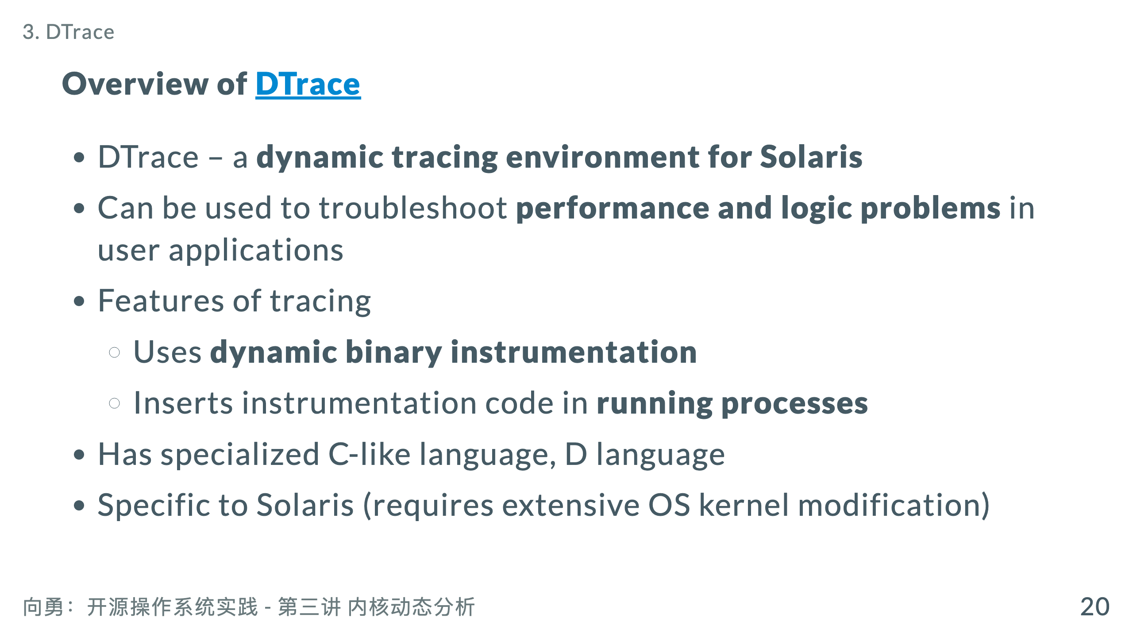
Notes:
* Terminology * Probes: points of instrumentation * Providers: make probes available

Slide 22
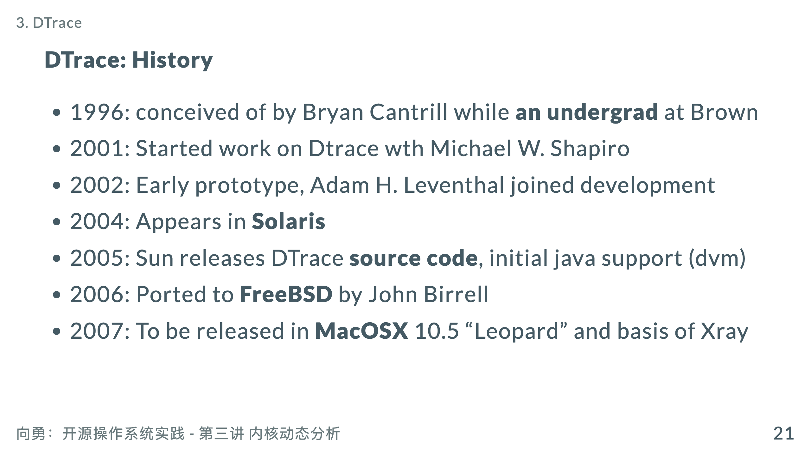

Slide 23
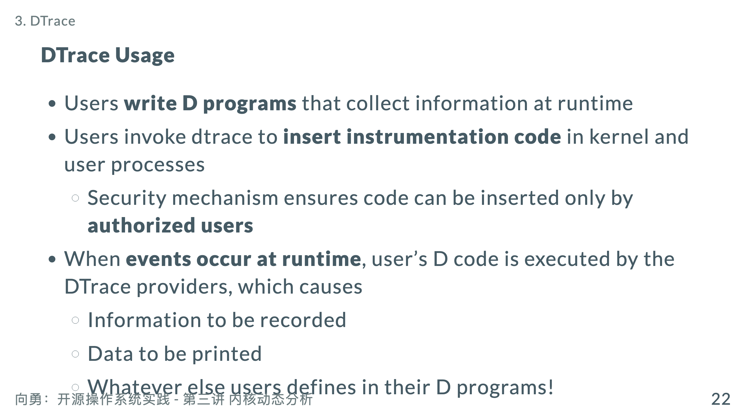
Notes:
* **Many, many providers** exist for getting lots of different data from running programs

Slide 24
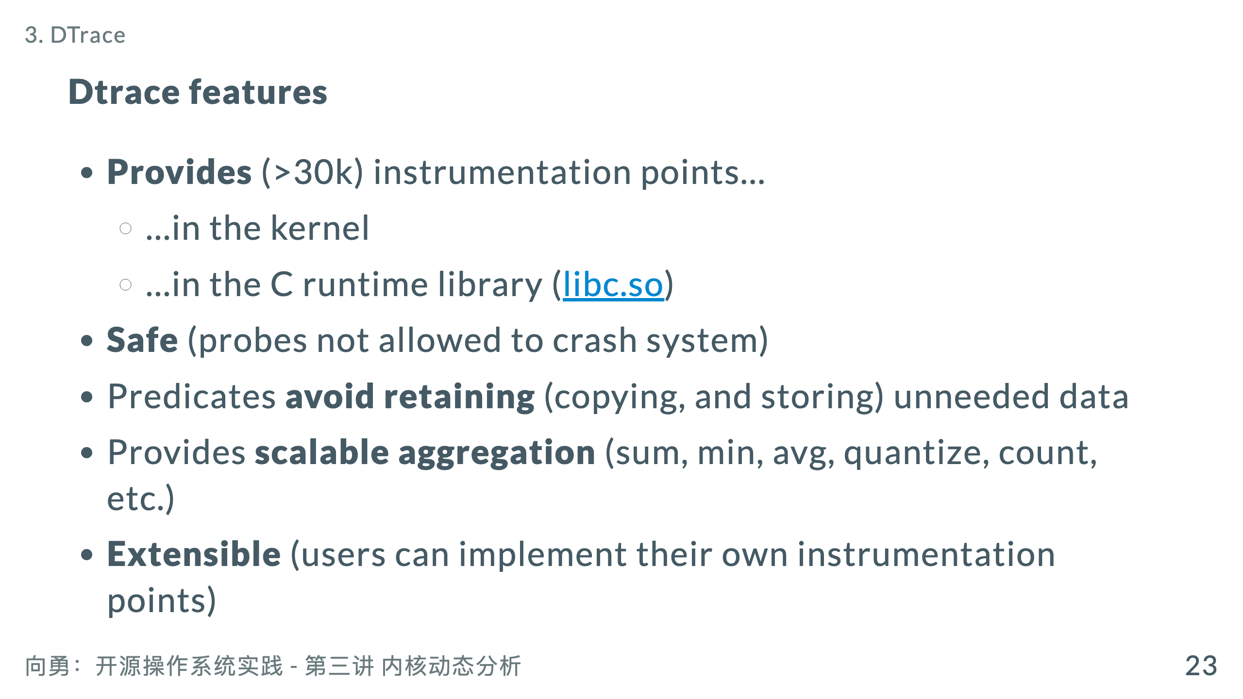
Notes:
* **Provides** (>30k) instrumentation points… * …in the kernel * …in the C runtime library (libc.so) * …in the Java VM (libjvm.so) * …in Java itself (starting with Java 1.6) * High level awk-like language, called D Retain (continue to have)保留 ‹property, salary, right›; 保持 ‹control, dignity, independence›

Slide 25
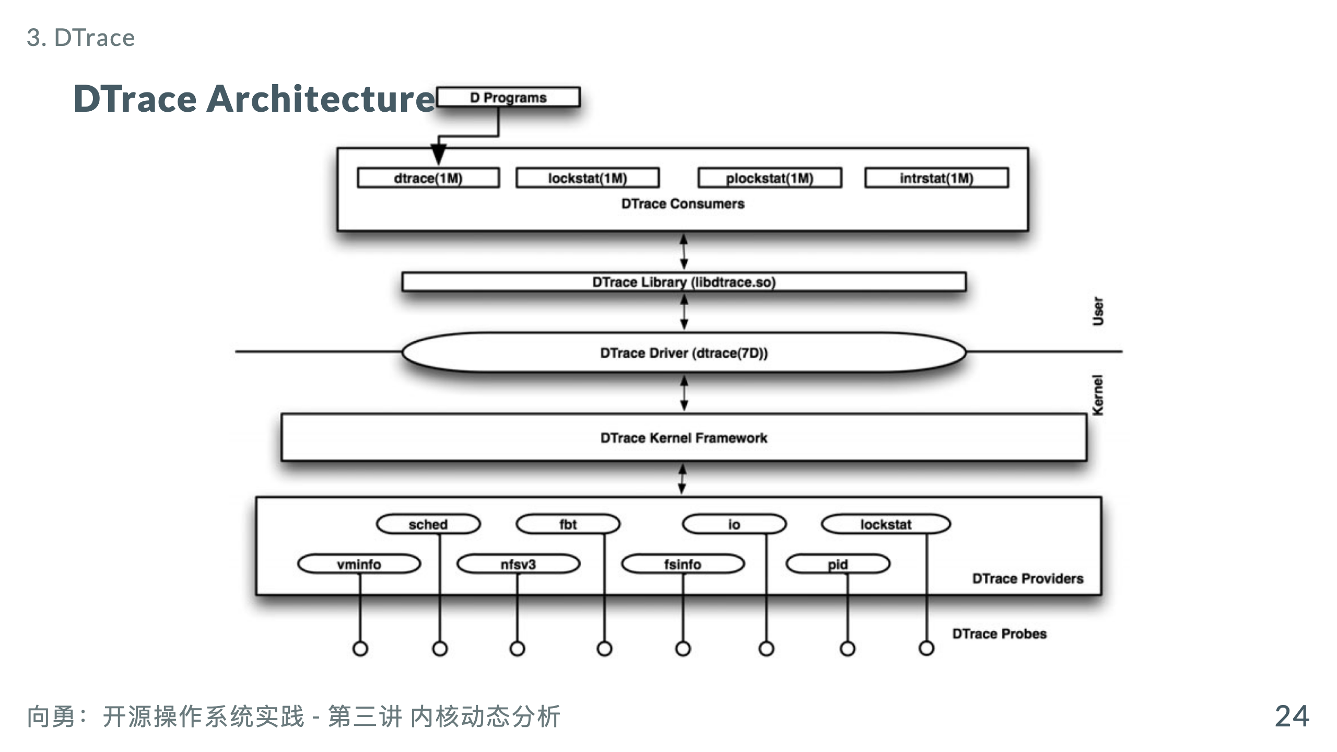

Slide 26
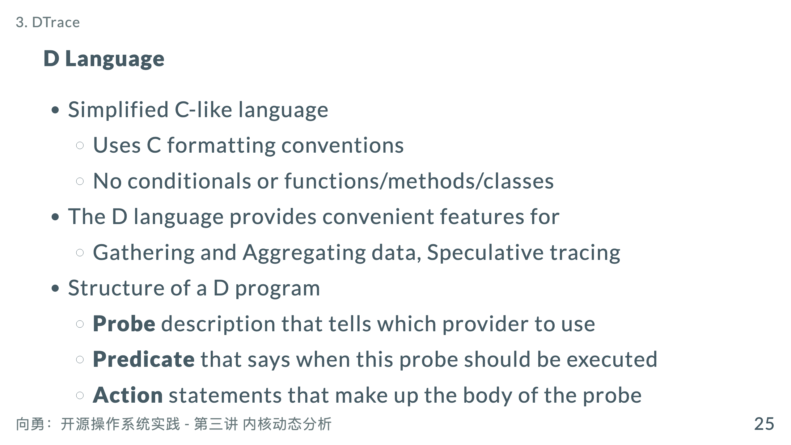
Notes:
* The D language provides convenient features for * Gathering and statistical information * Aggregating data * Displaying function arguments or timing information (printf-like syntax) * Speculative tracing Speculative (of an investment) involving a high risk of loss.

Slide 27
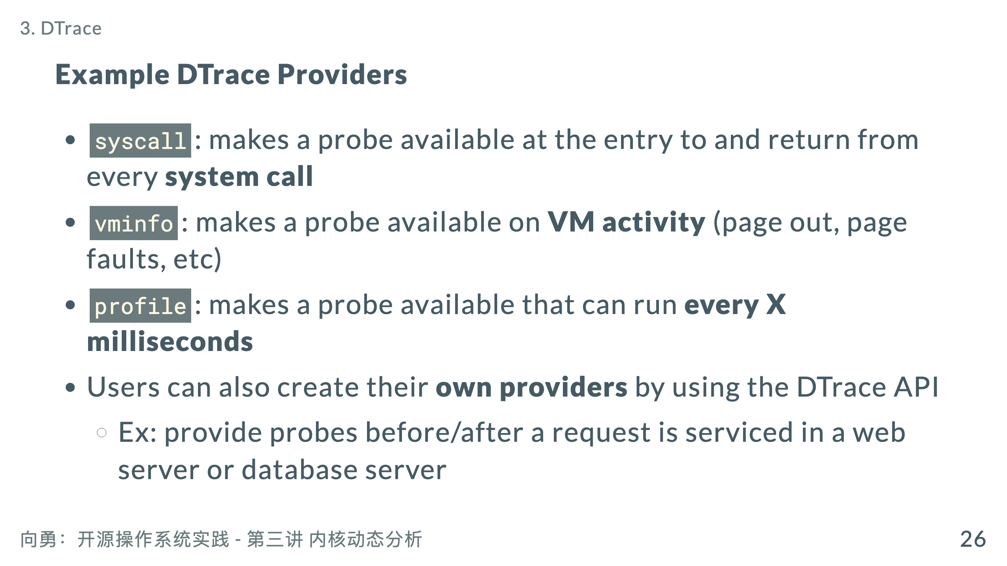
Notes:
* `fpuinfo`: makes a probe available when **hardware floating point operations** are emulated in software

Slide 28
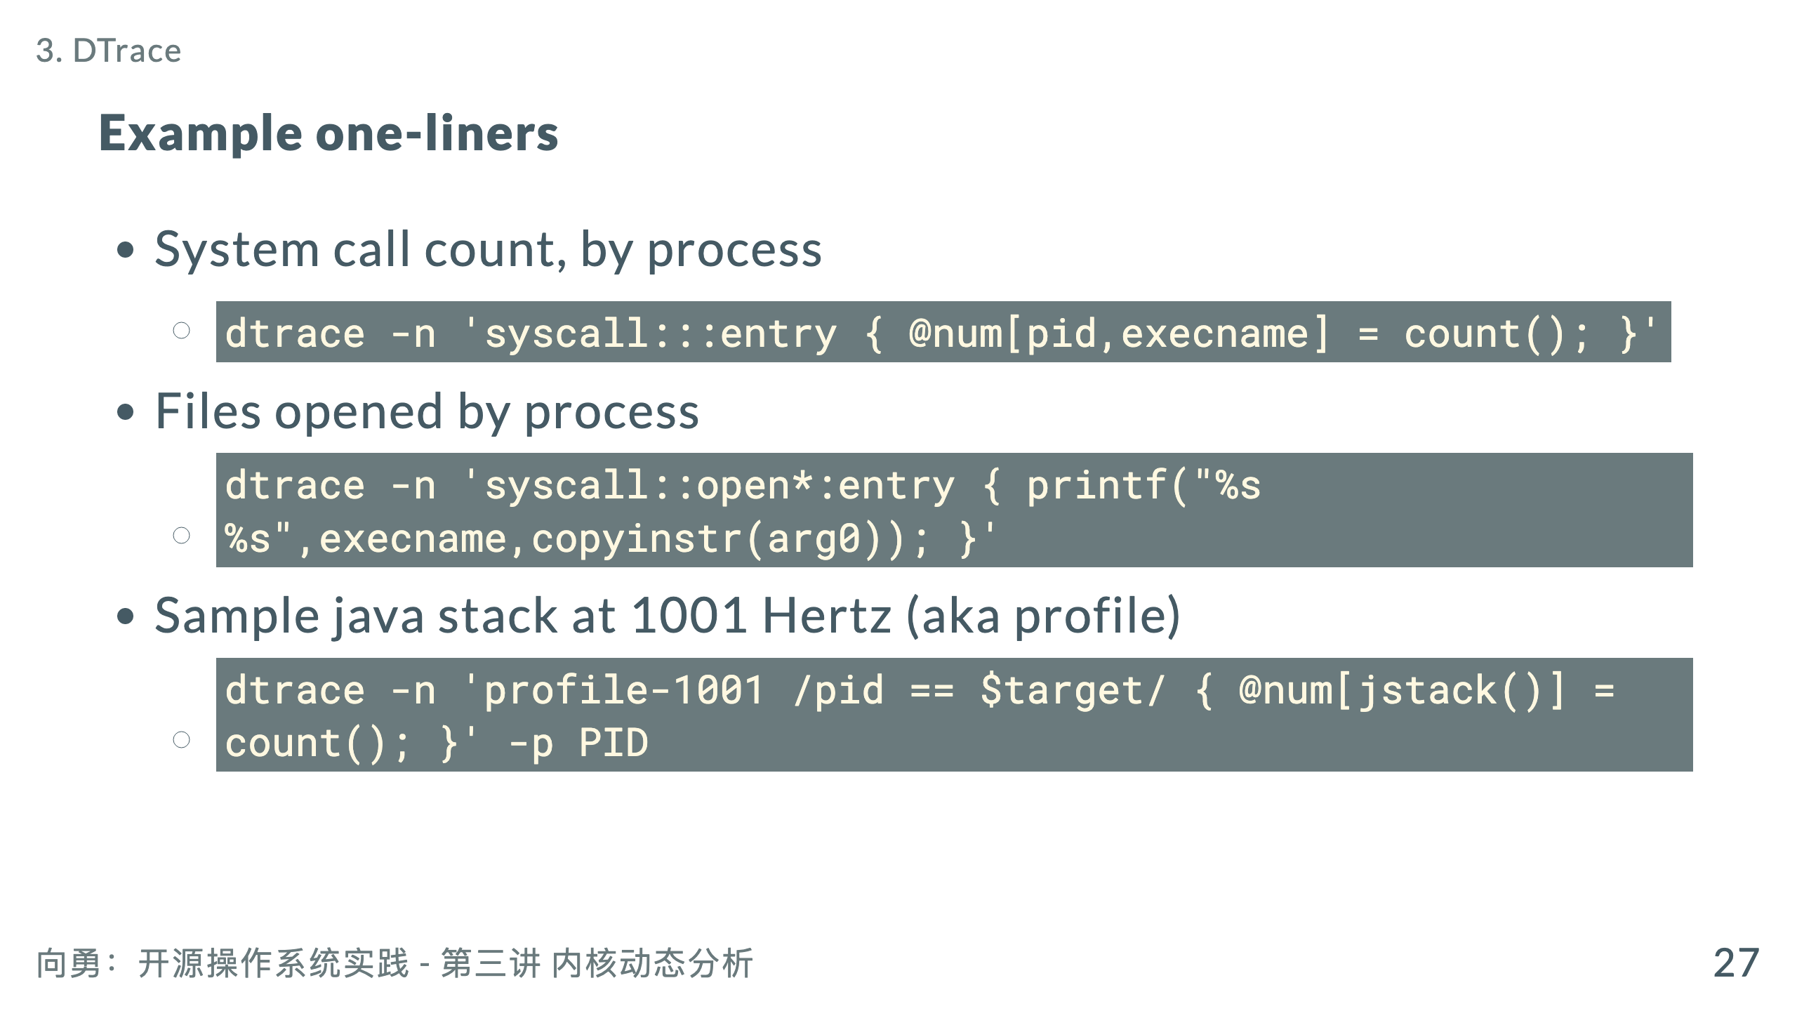
Notes:
* Number of bytes read, by process * `dtrace -n 'sysinfo:::readch { @bytes[execname] = sum(arg0); }'` * Write size distribution, by process * `dtrace -n 'sysinfo:::writech { @dist[execname] = quantize(arg0); }'`

Slide 29
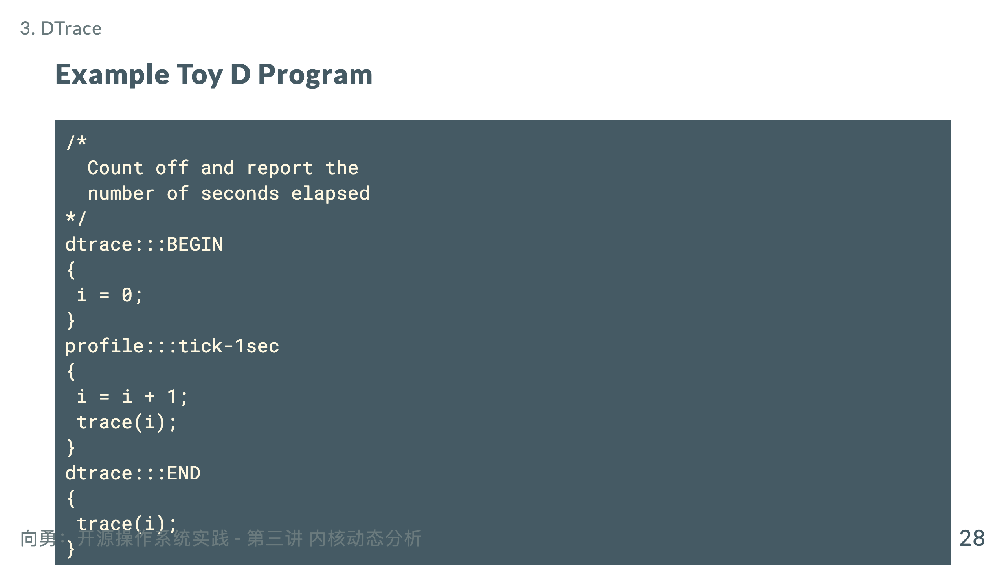

Slide 30
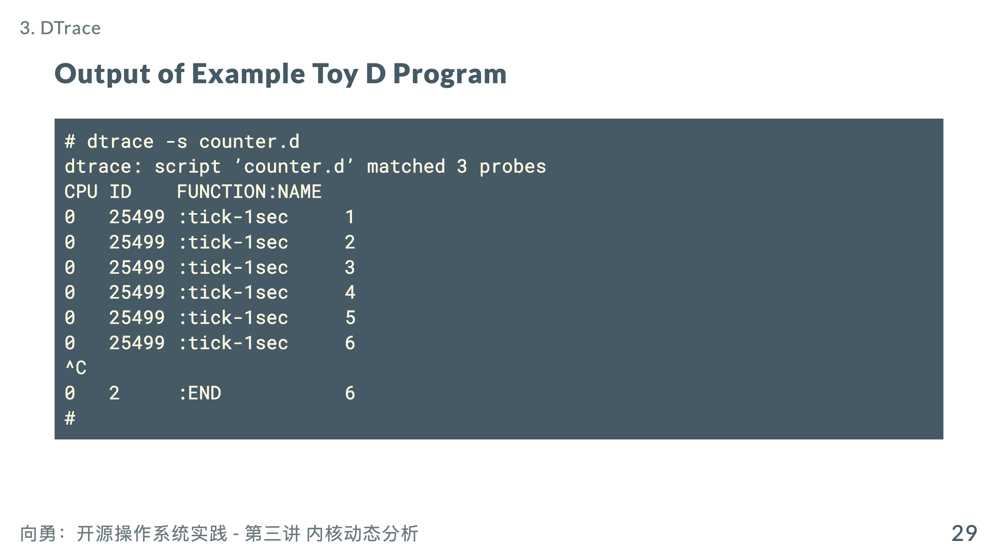

Slide 31
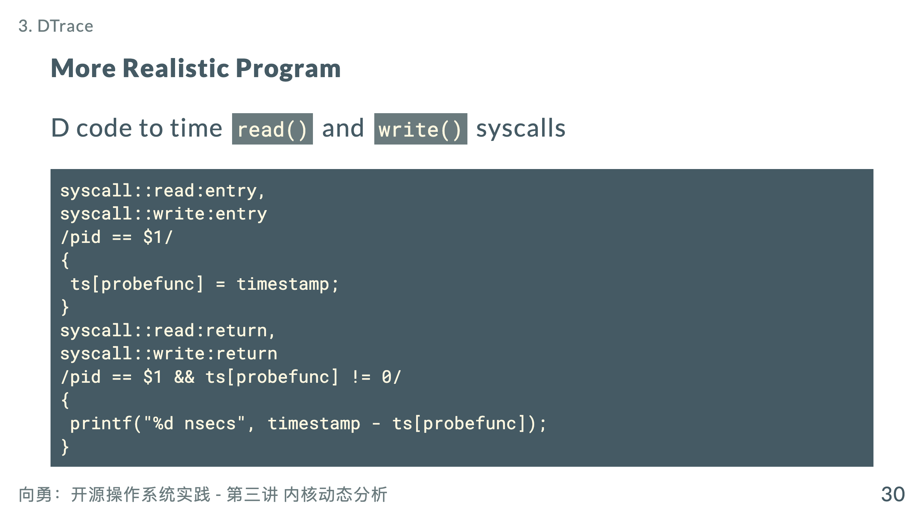

Slide 32
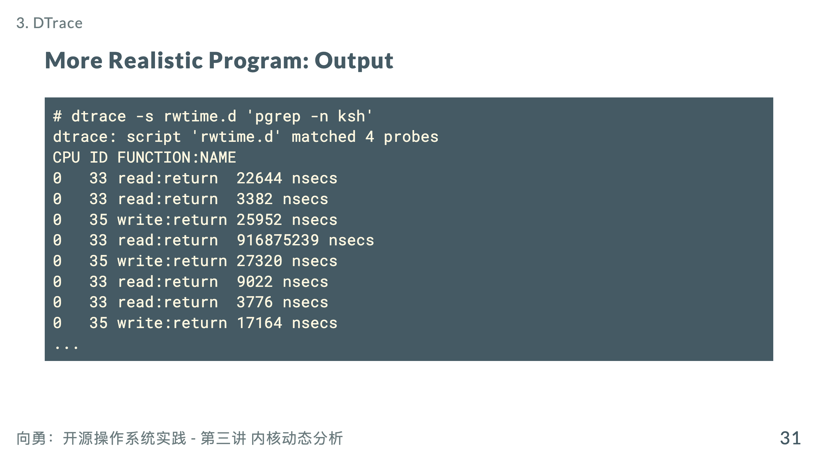

Slide 33
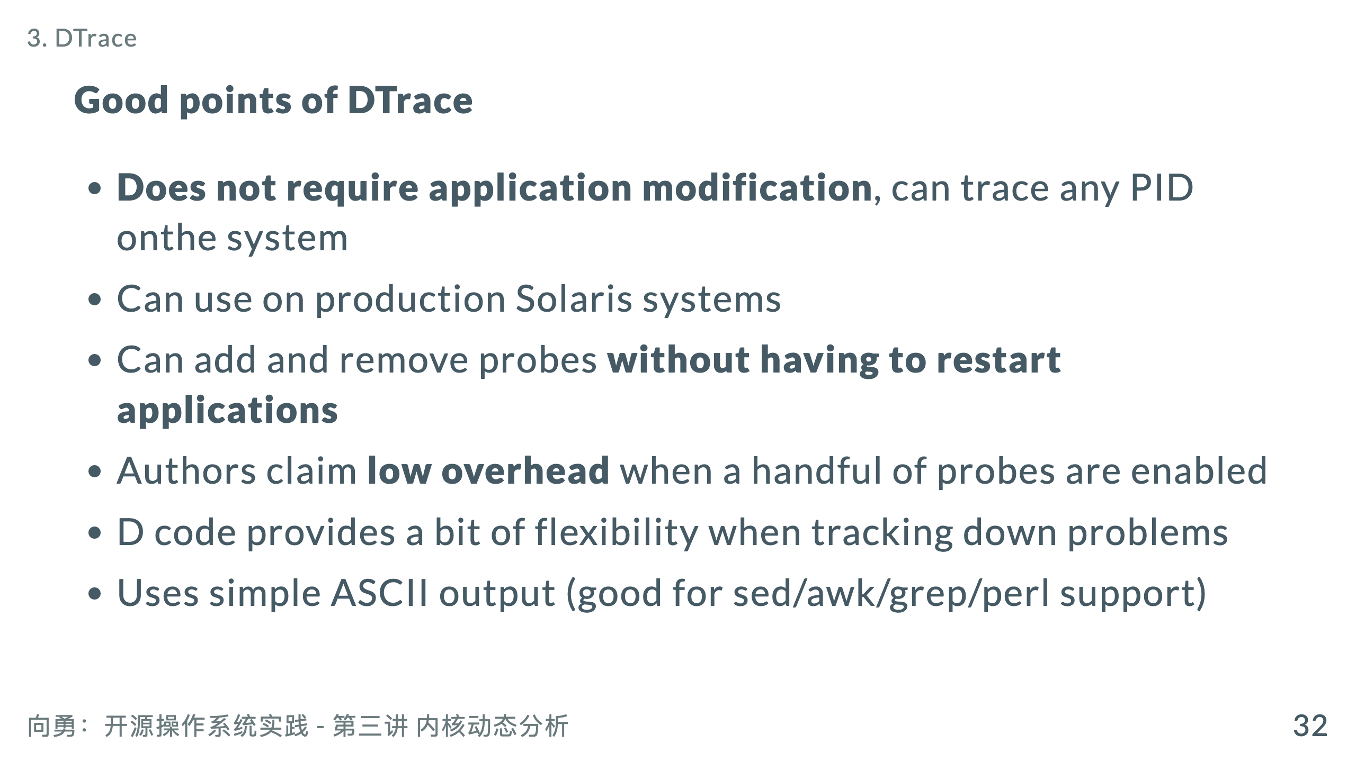

Slide 34
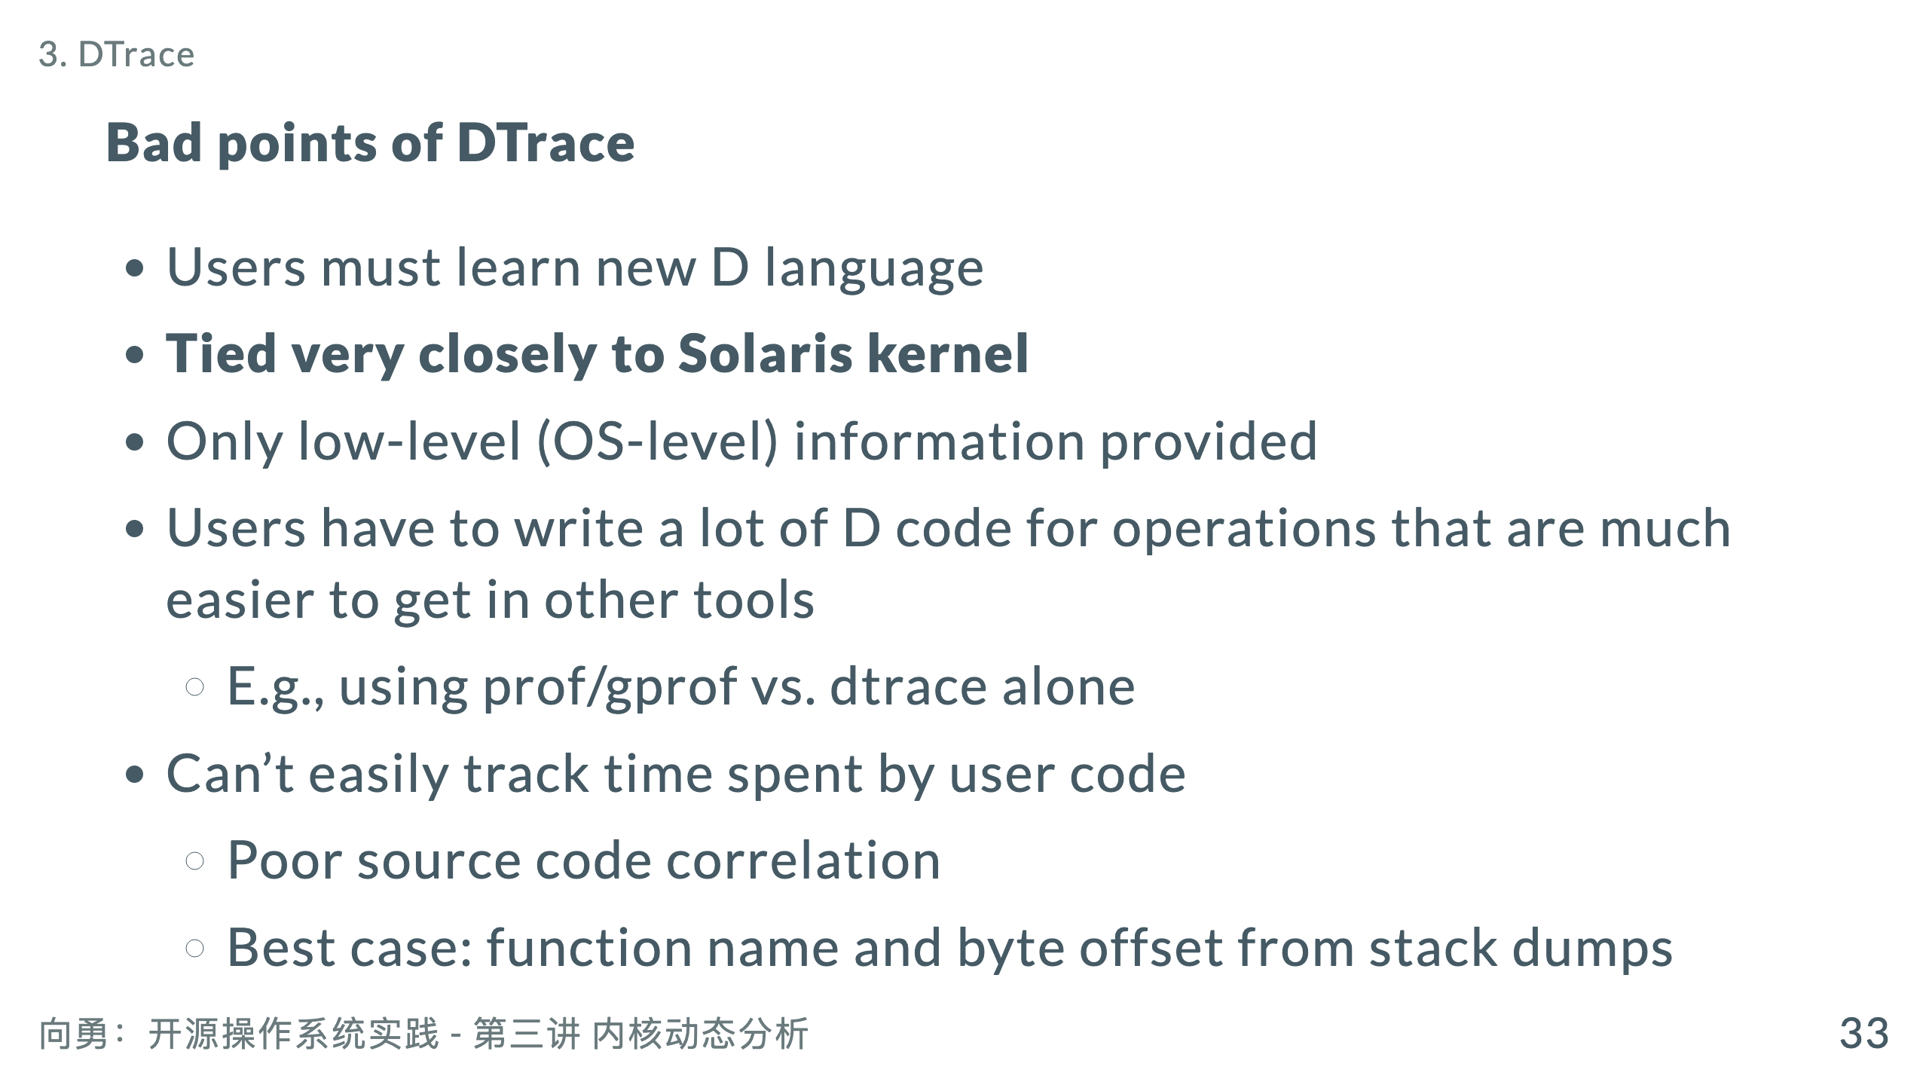

Slide 35
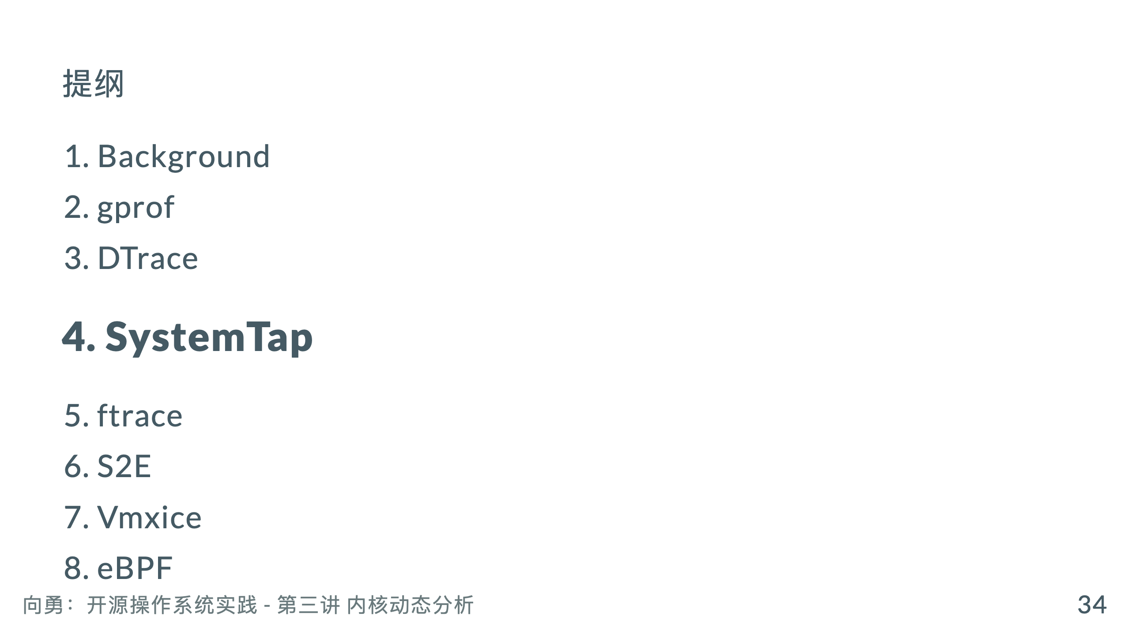

Slide 36
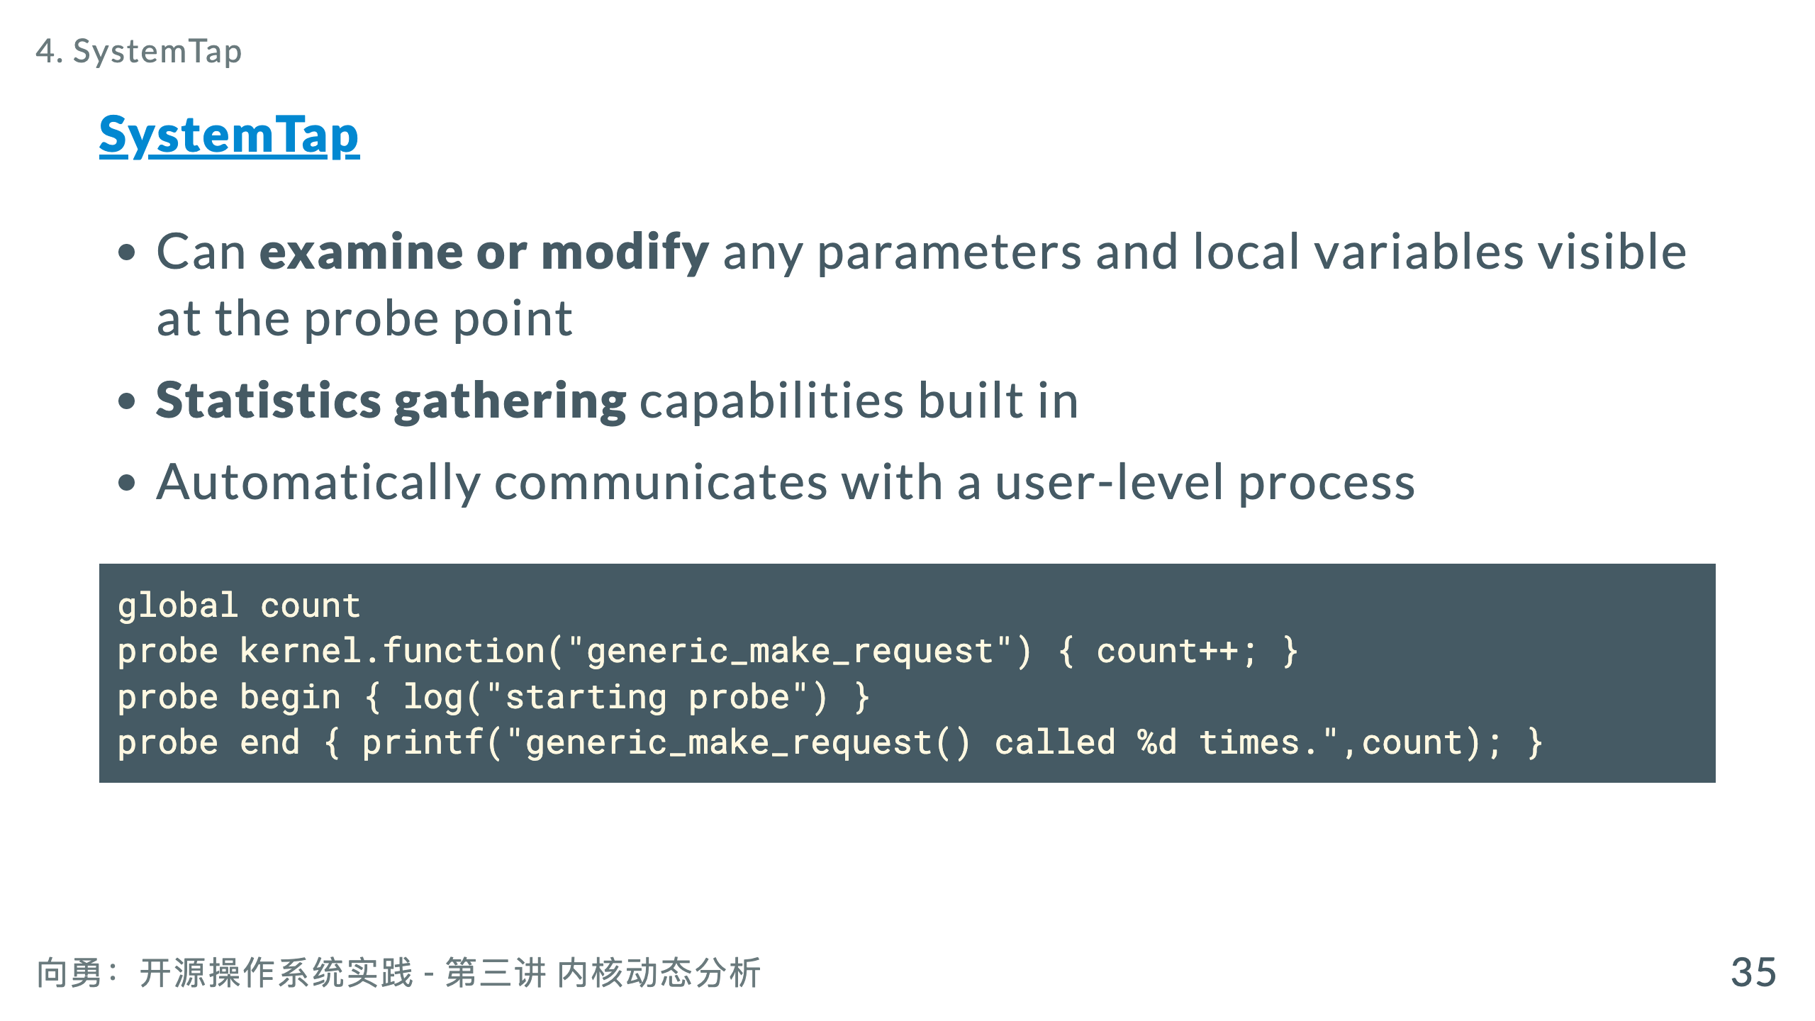
Notes:
* A number of safety features make it far harder to crash a running kernel

Slide 37
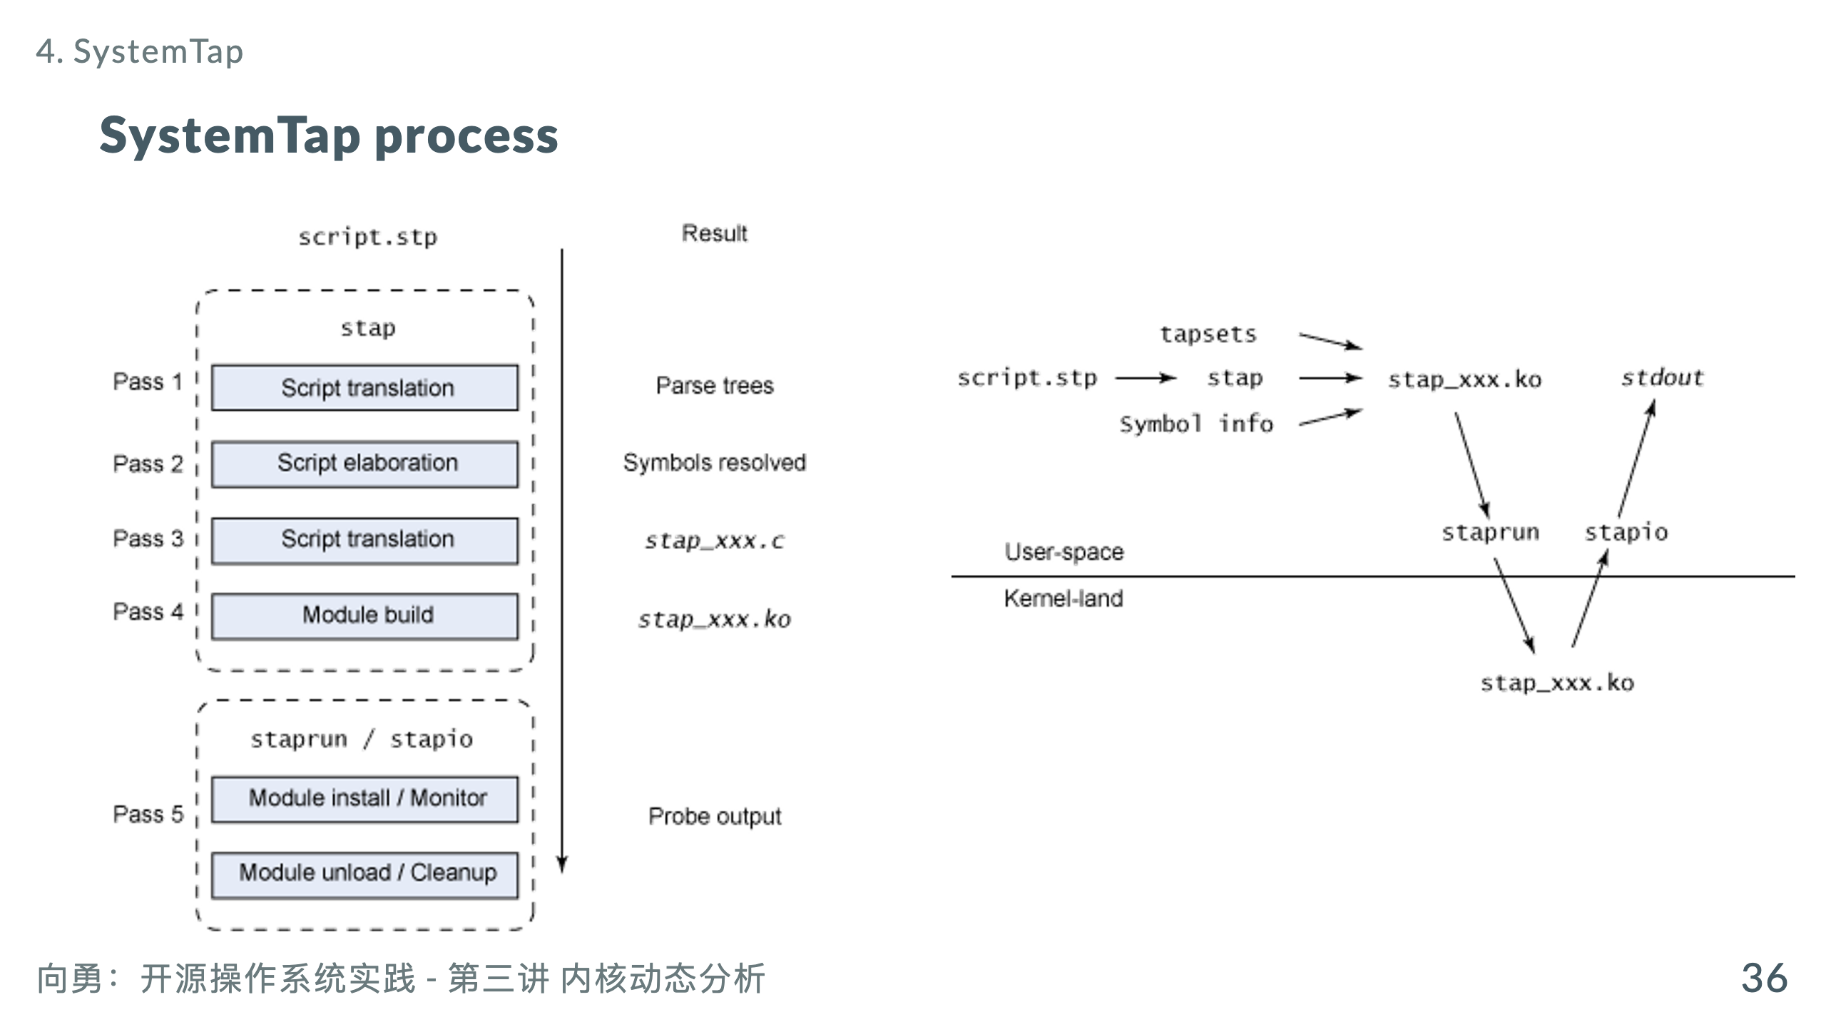

Slide 38
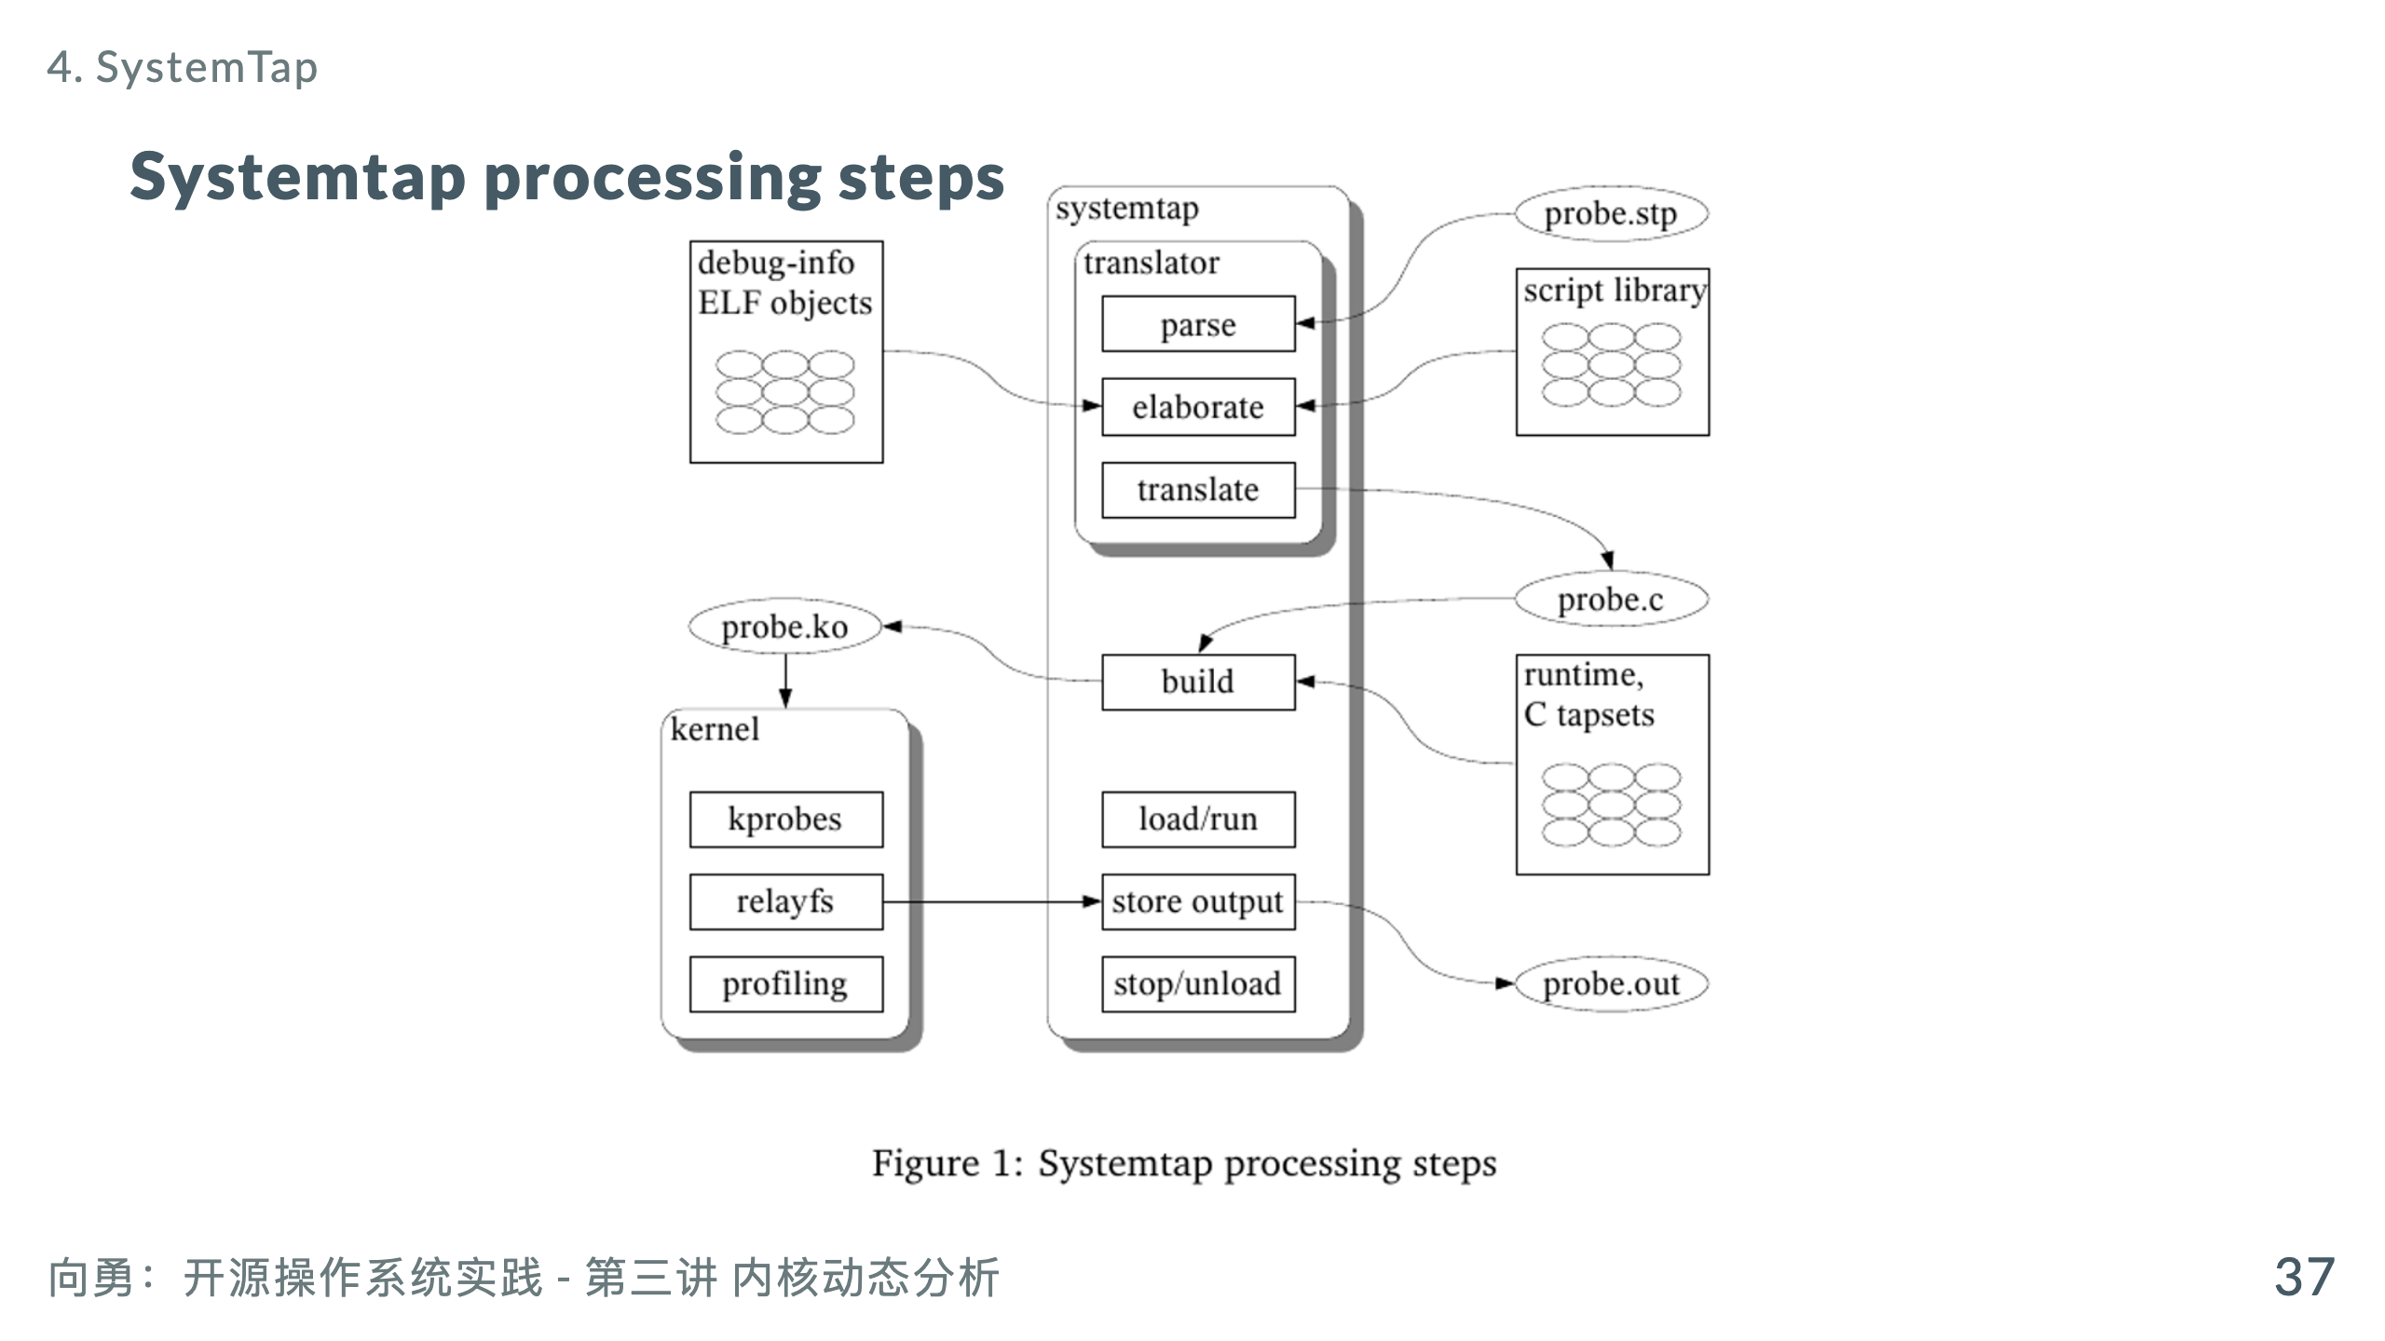

Slide 39
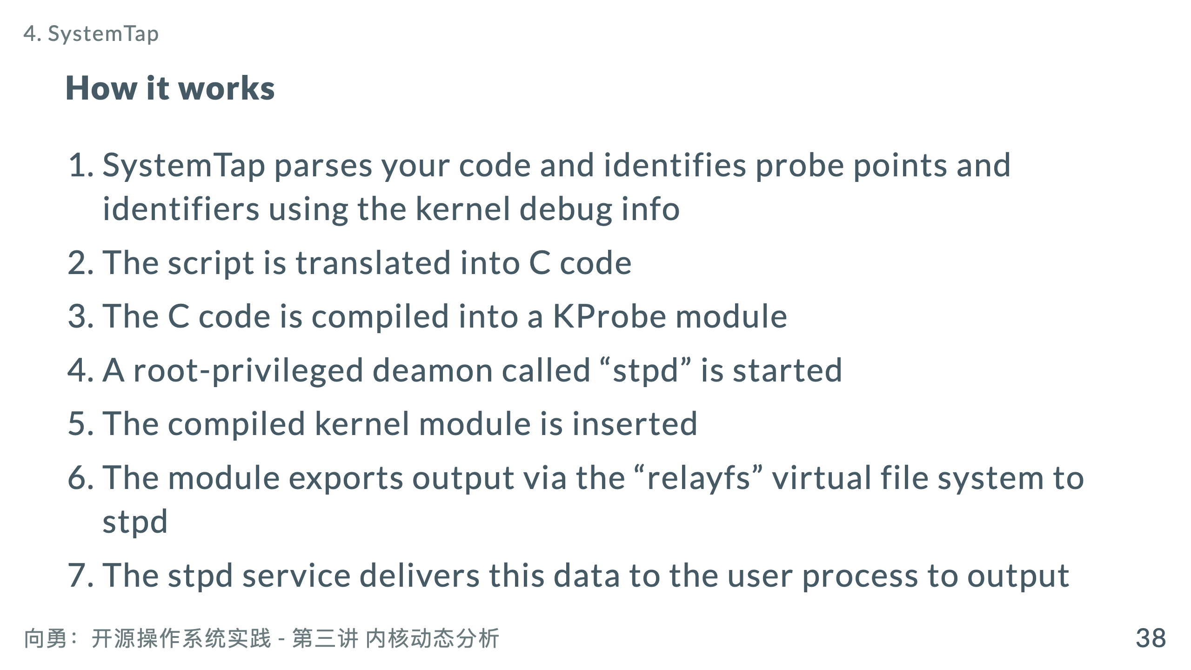

Slide 40
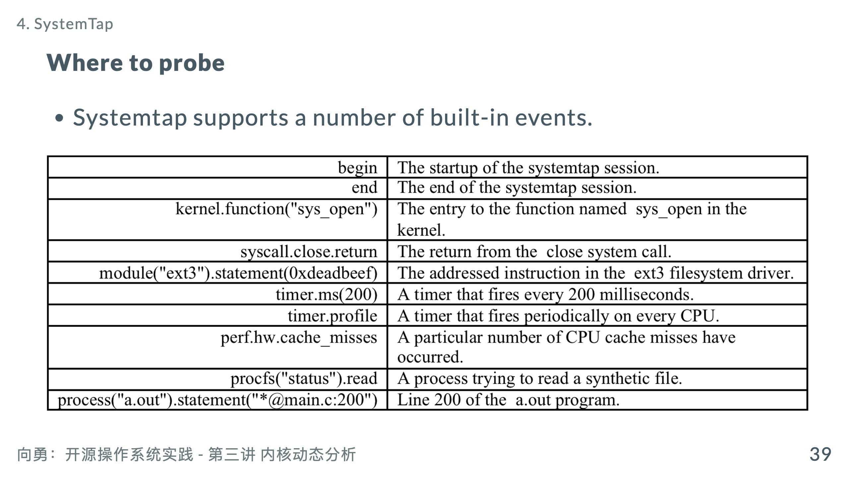

Slide 41
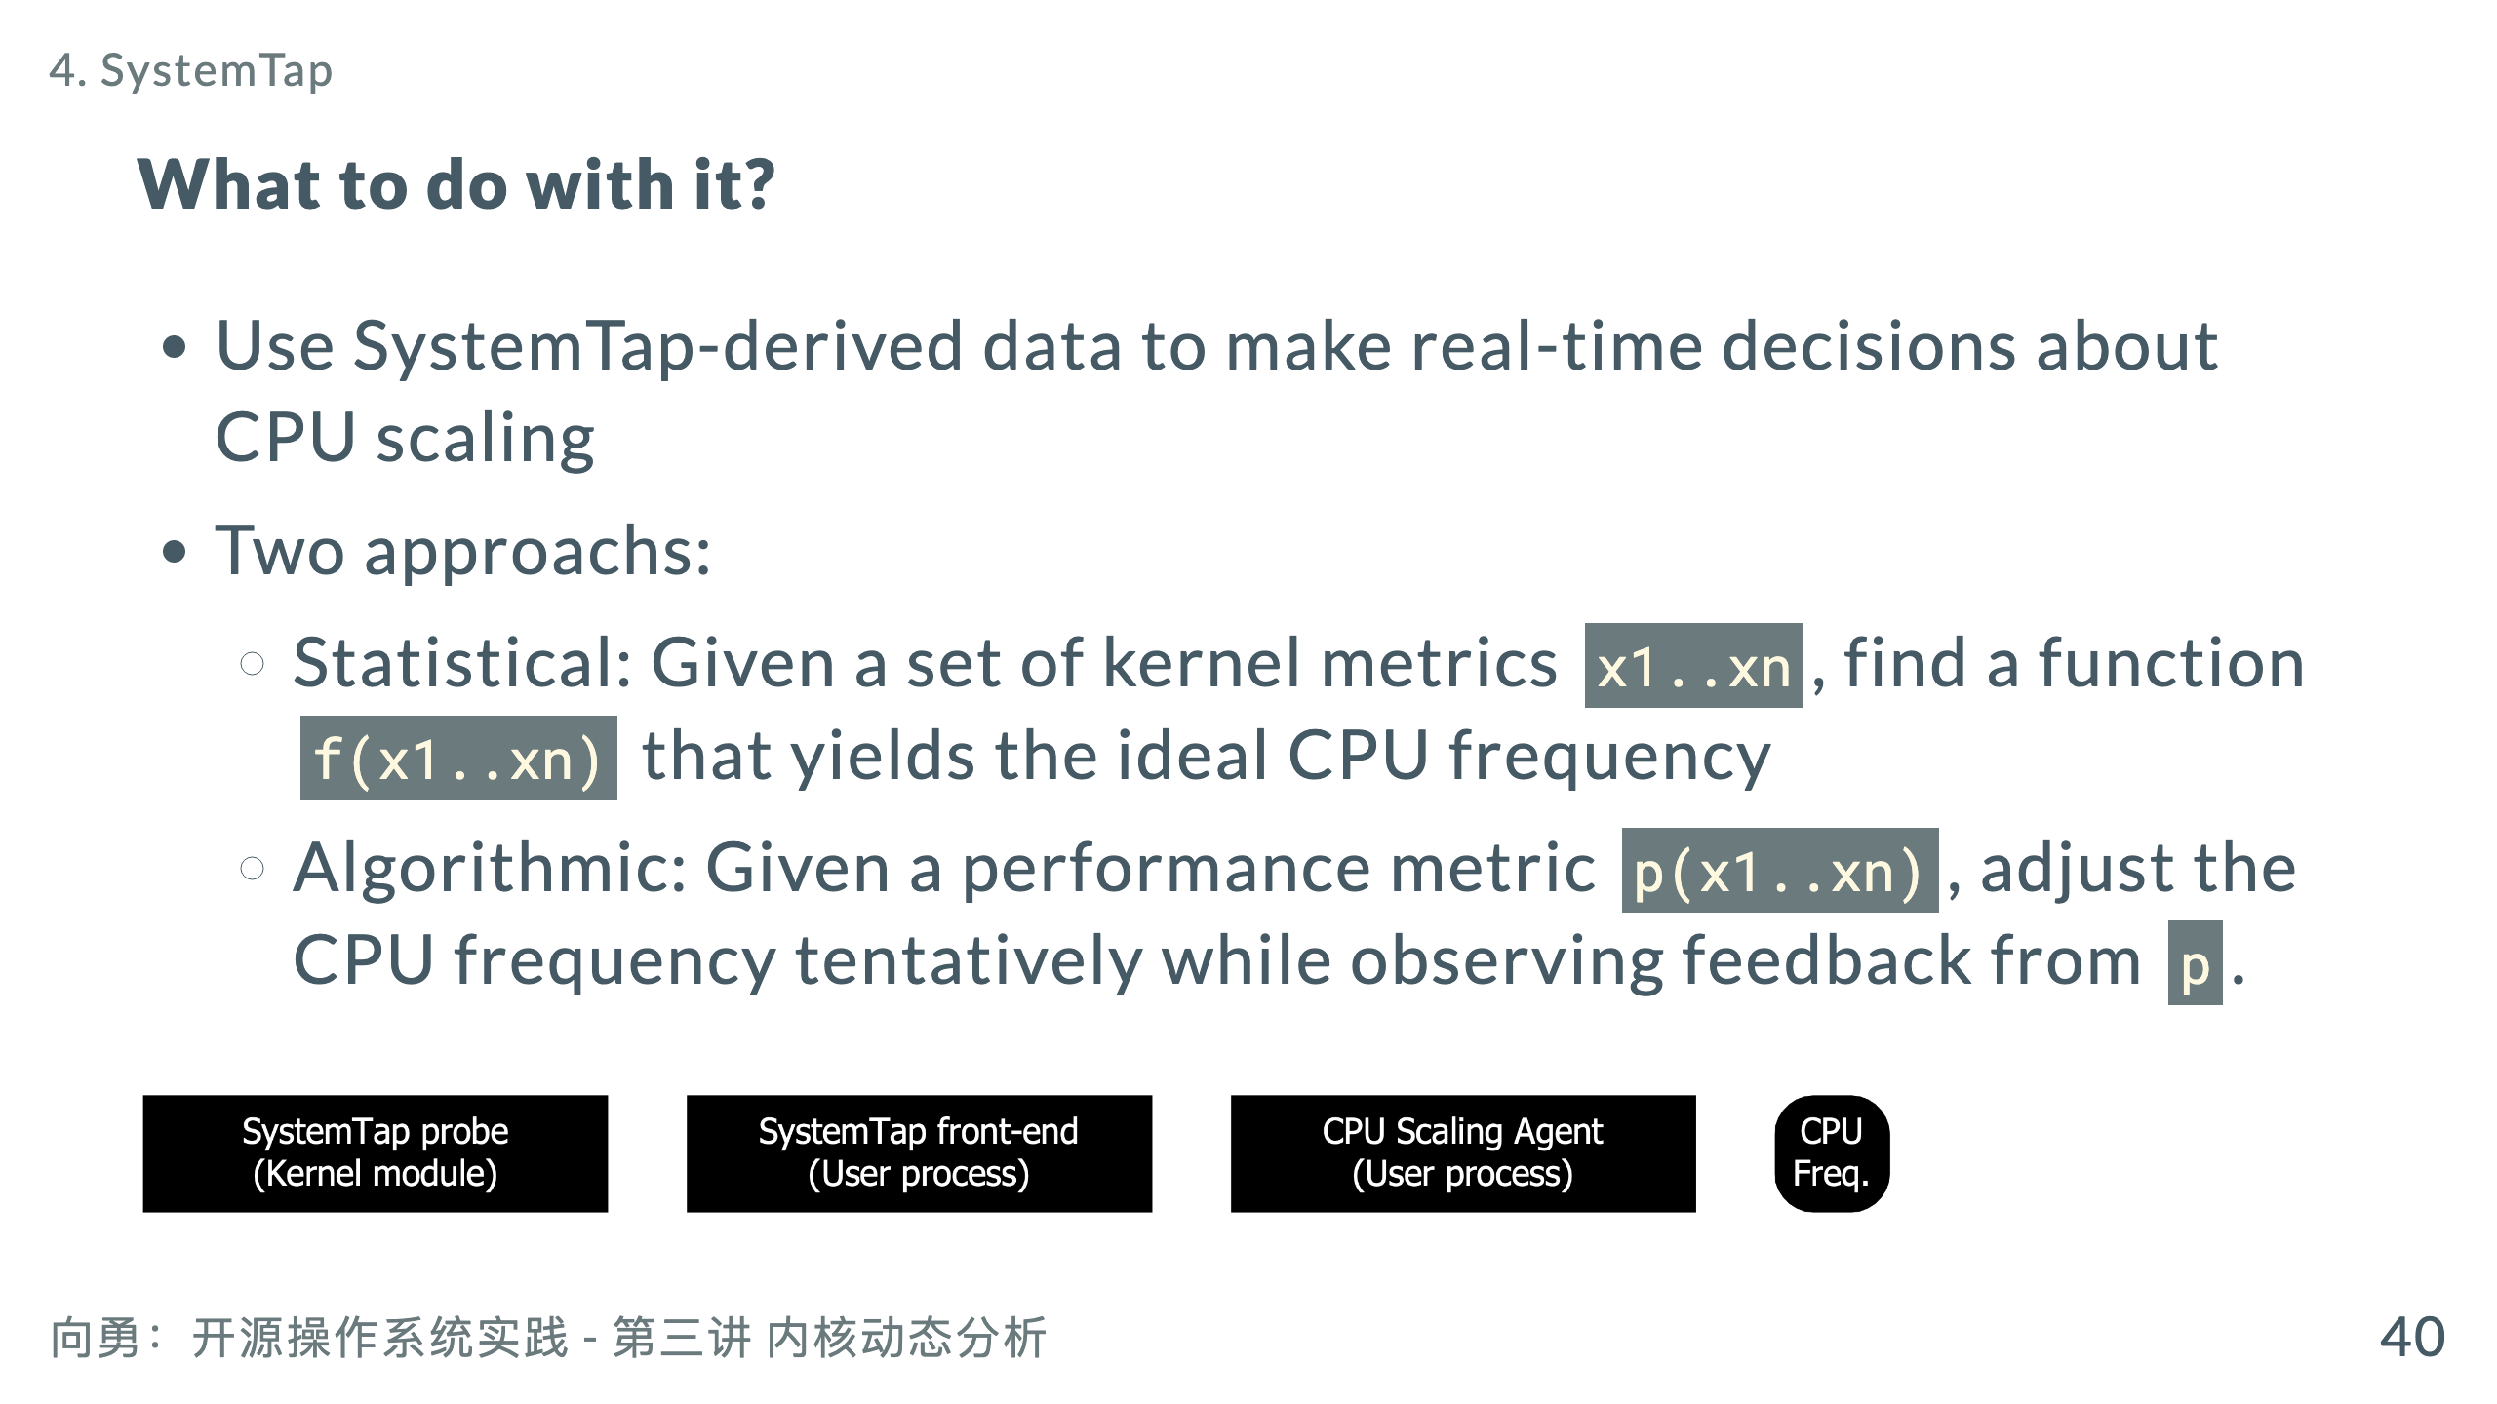

Slide 42
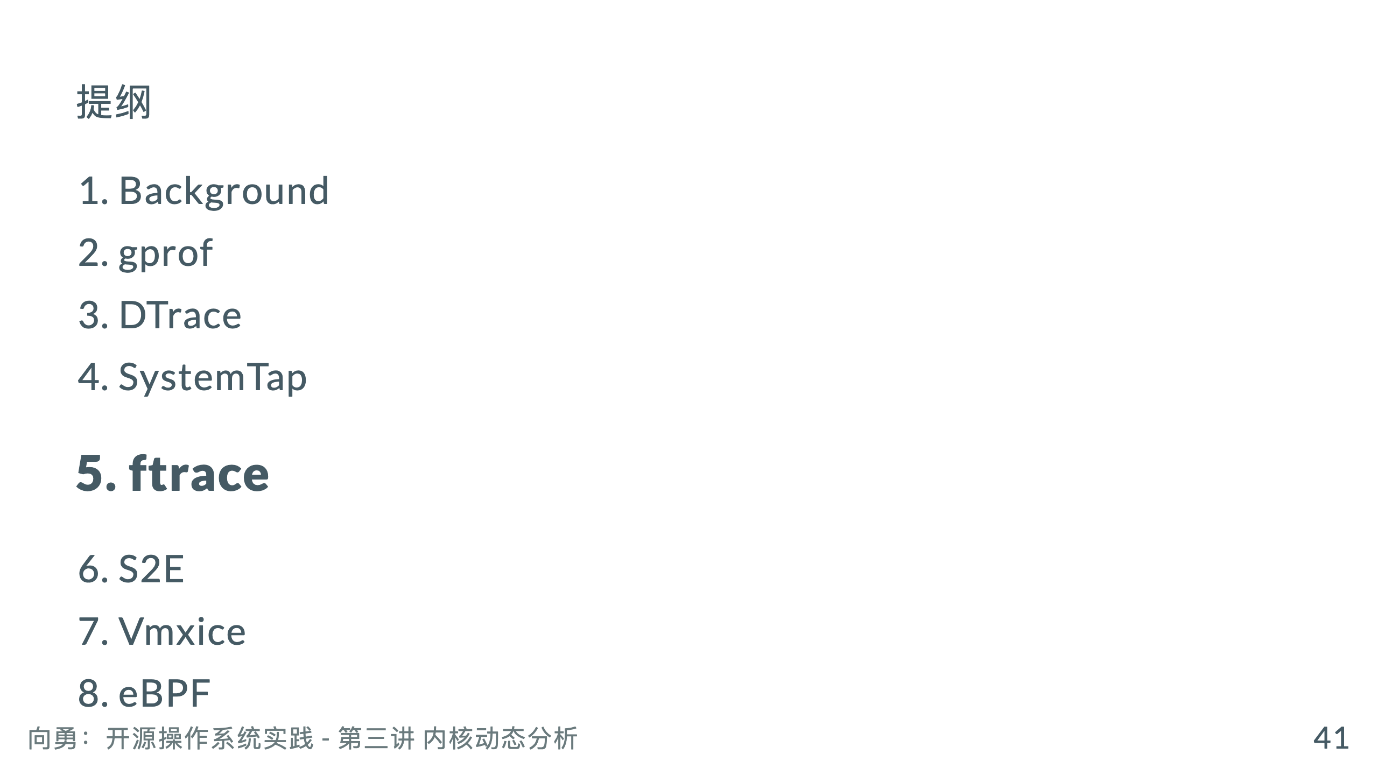

Slide 43
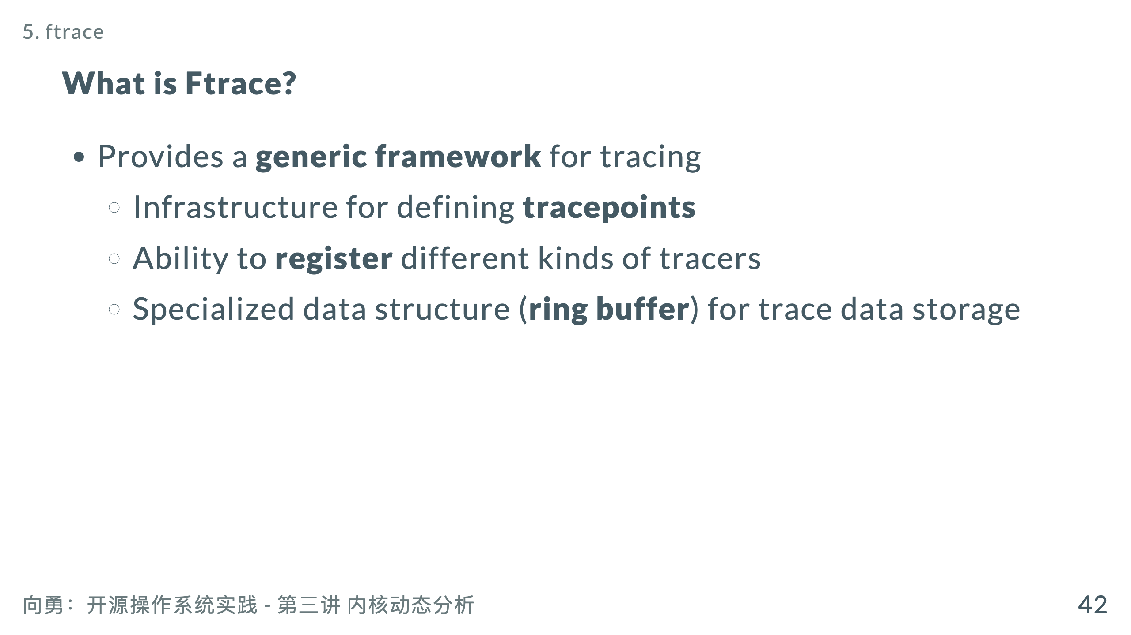
Notes:
SystemTap 设计比较复杂 不当的使用和 SystemTap 自身的不完善都有可能导致系统崩溃 ftrace 代码量很小，稳定可靠。 ftrace 有定义良好的 ASCII 接口，可以直接阅读 ftrace 对所有 tracer 都采用同一个 ring buffer Ftrace 的实现依赖于其他很多内核特性，比如 tracepoint[3]，debugfs[2]，kprobe[4]，IRQ-Flags[5] 等。

Slide 44
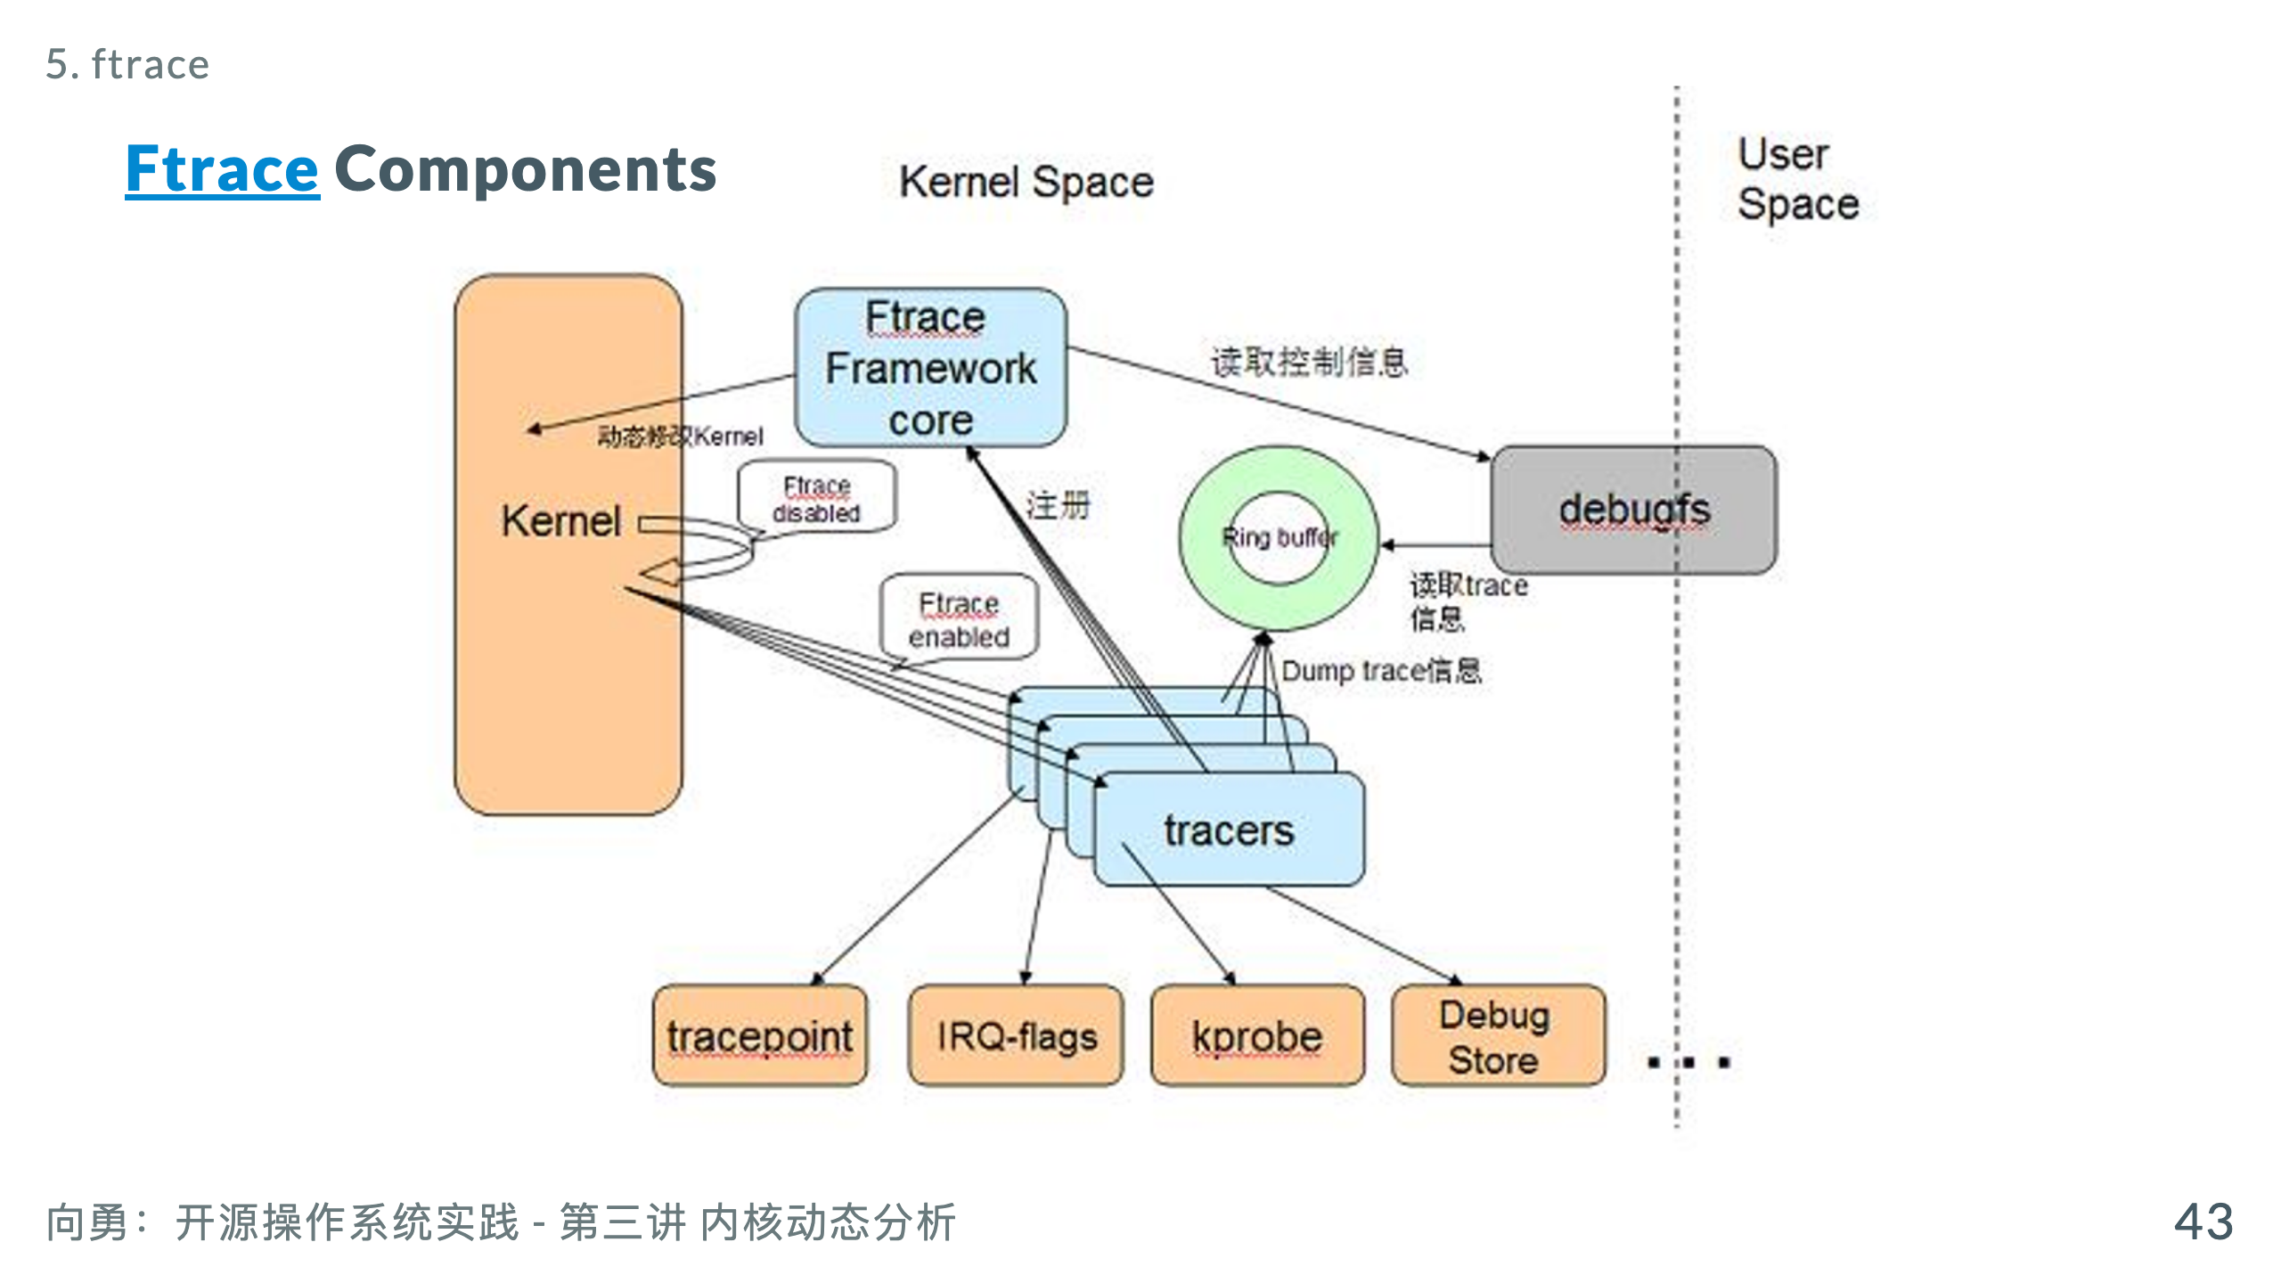
Notes:
https://www.kernel.org/doc/html/latest/trace/ftrace.html https://opensource.com/article/21/7/linux-kernel-ftrace https://zhuanlan.zhihu.com/p/479823151 https://www.cnblogs.com/slgkaifa/p/6919967.html https://zhuanlan.zhihu.com/p/27190018

Slide 45
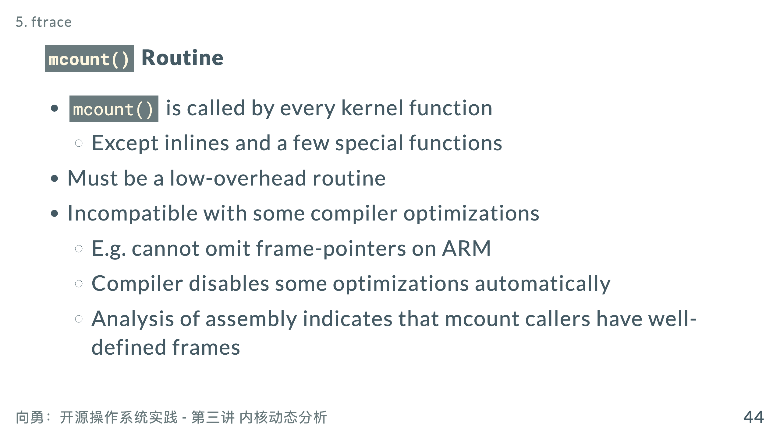

Slide 46
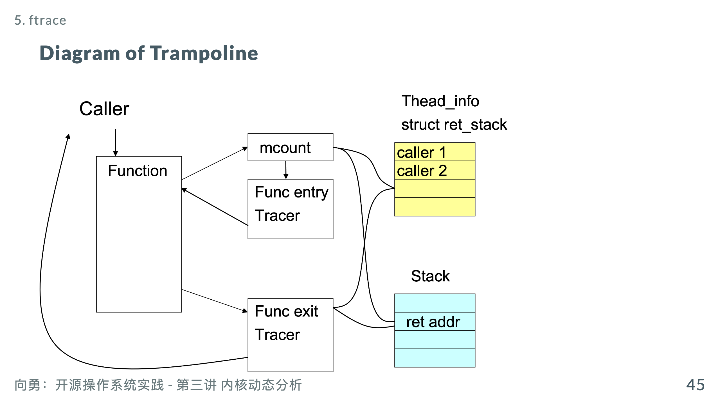

Slide 47
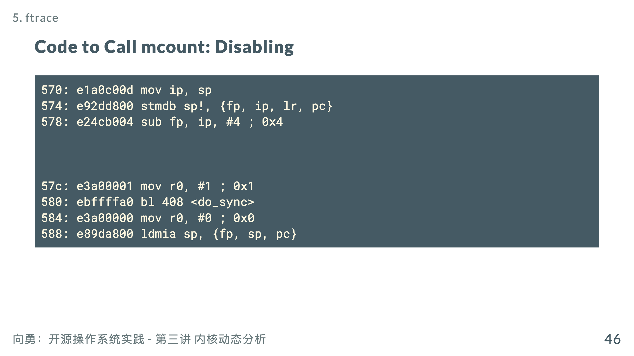

Slide 48
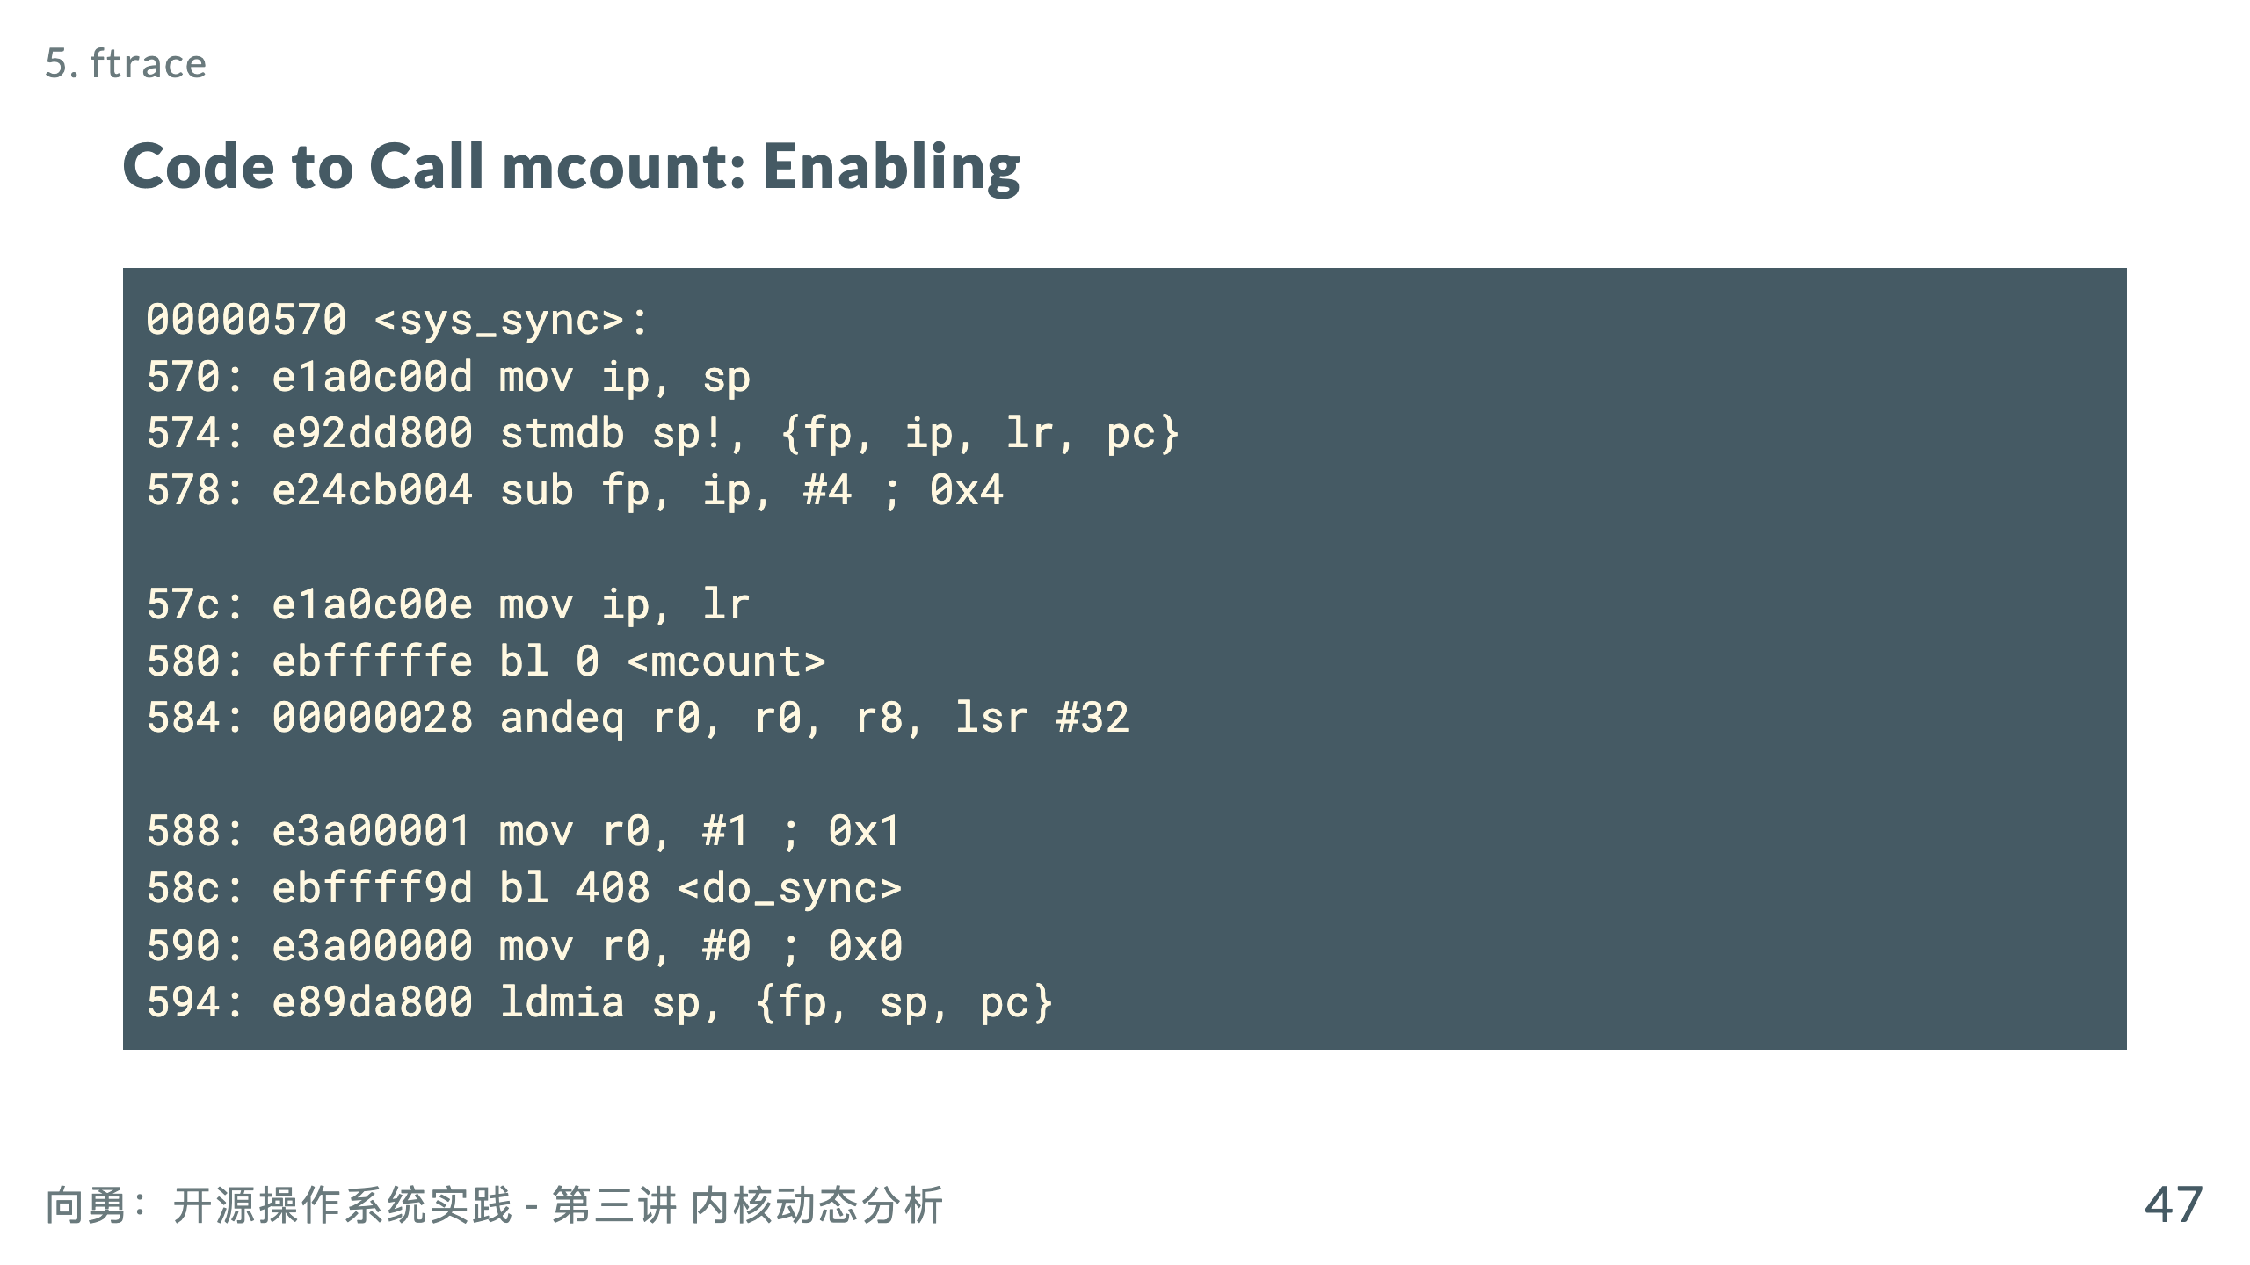

Slide 49
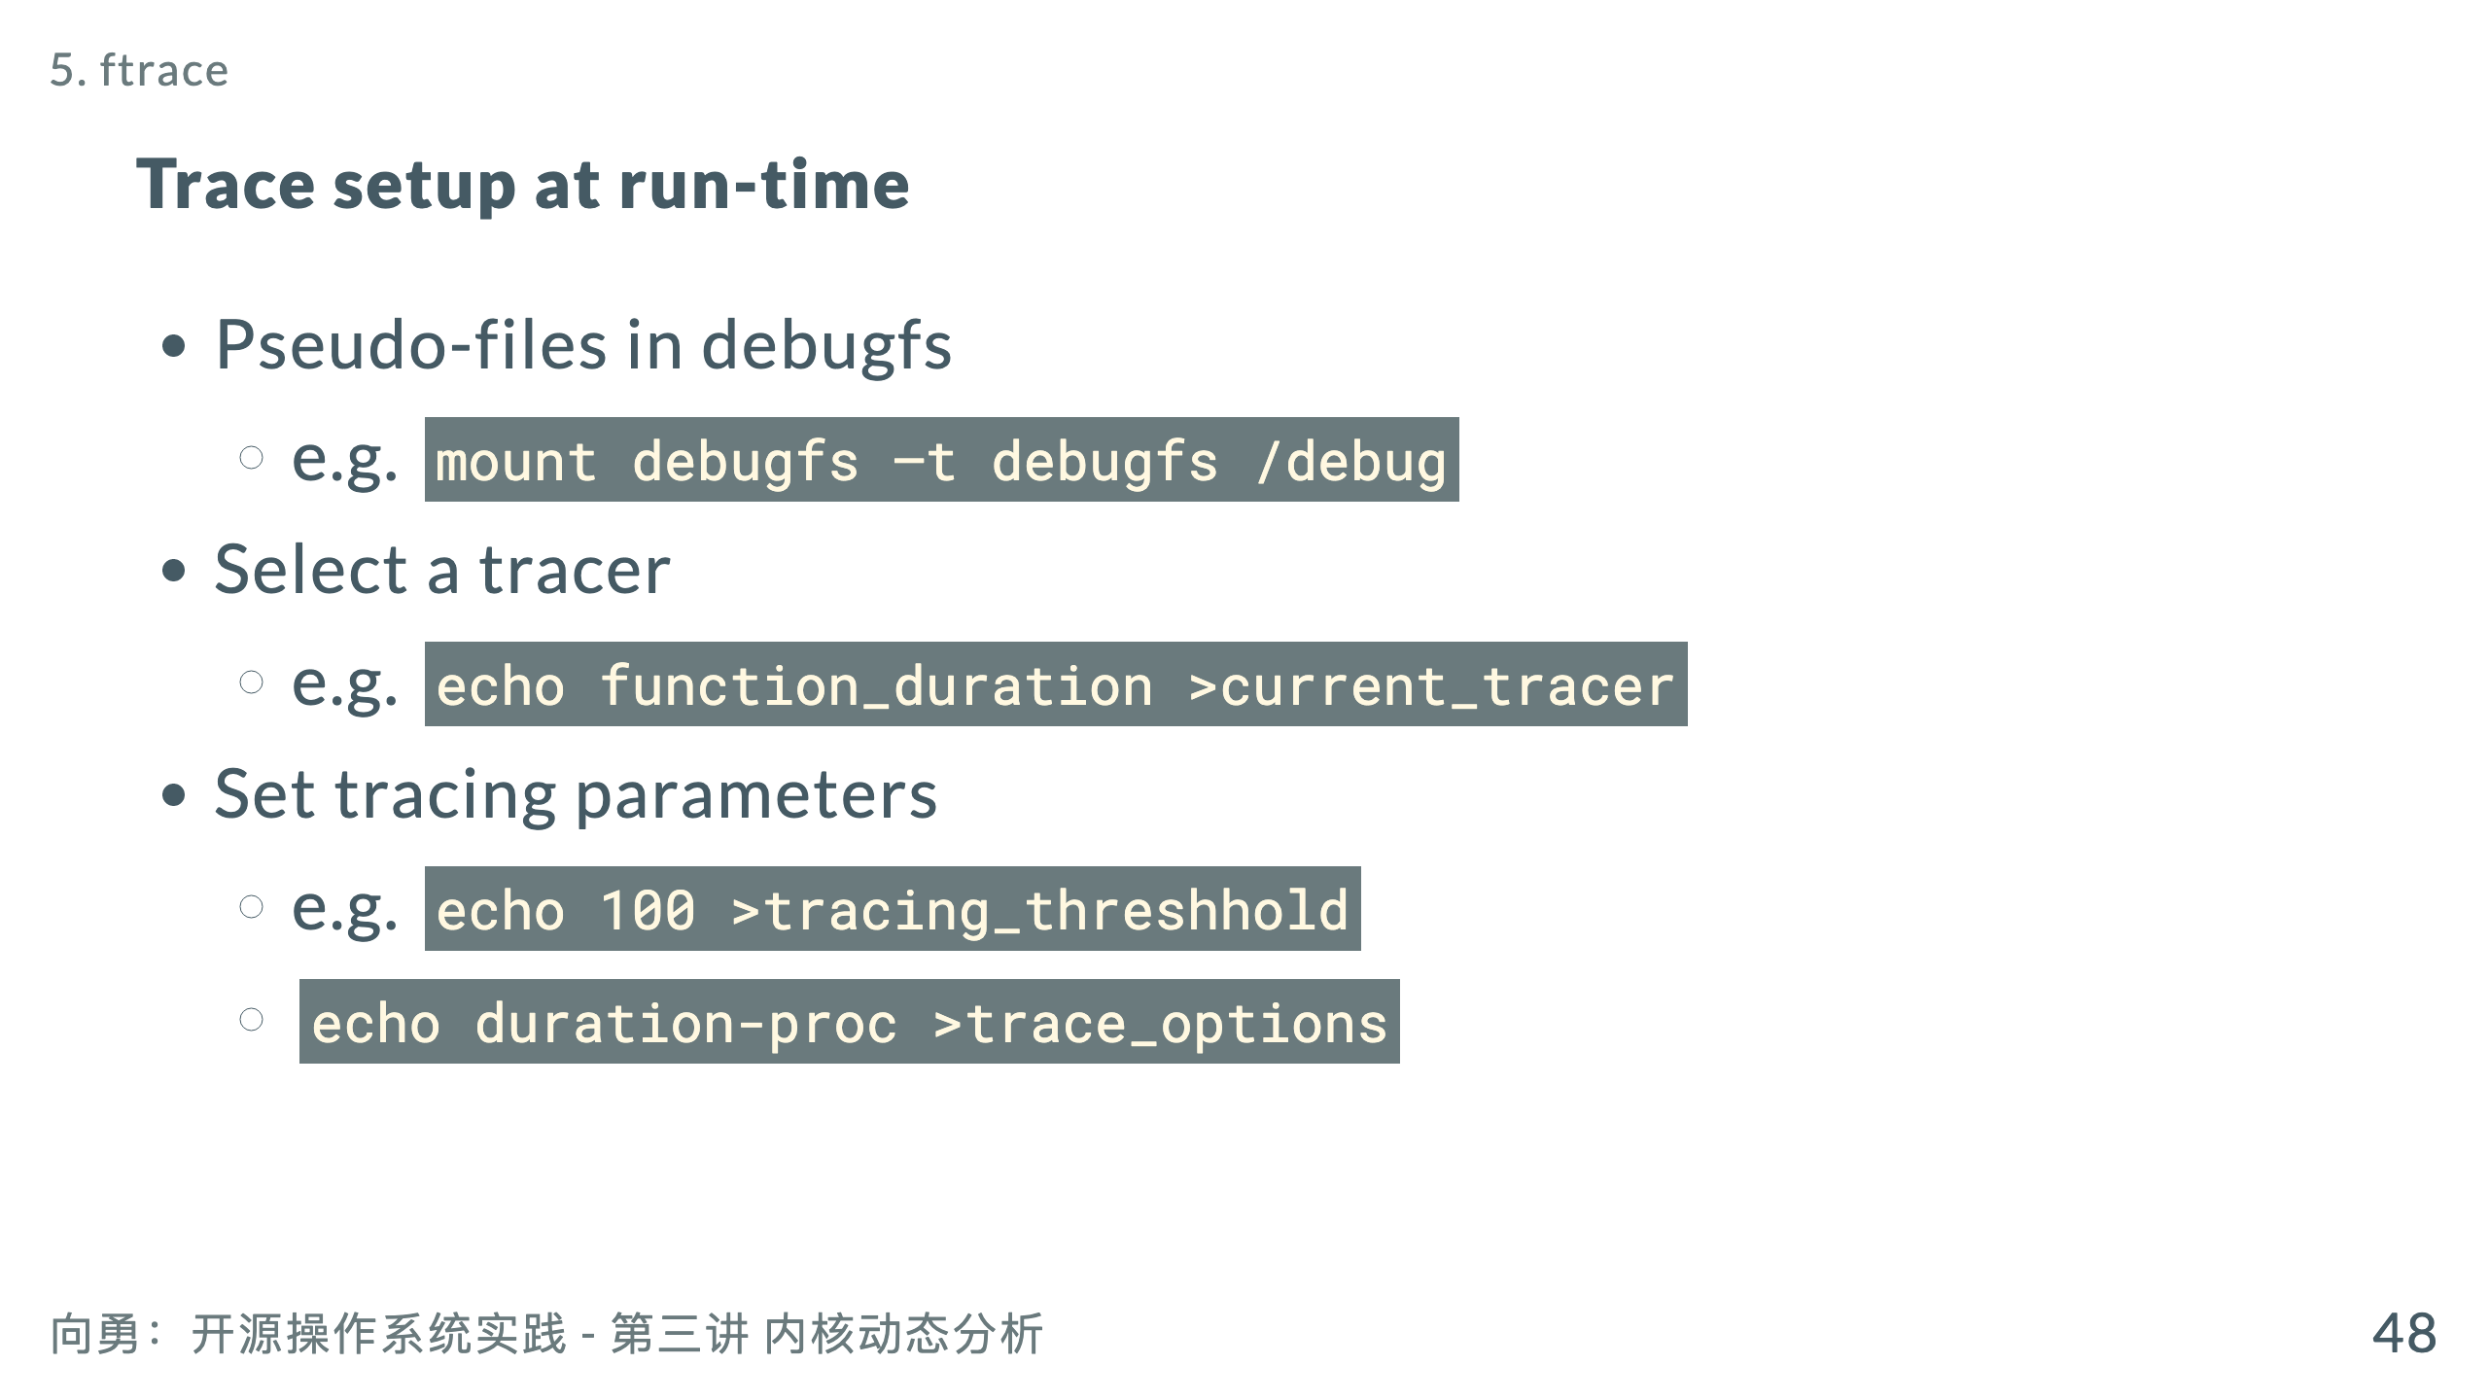

Slide 50
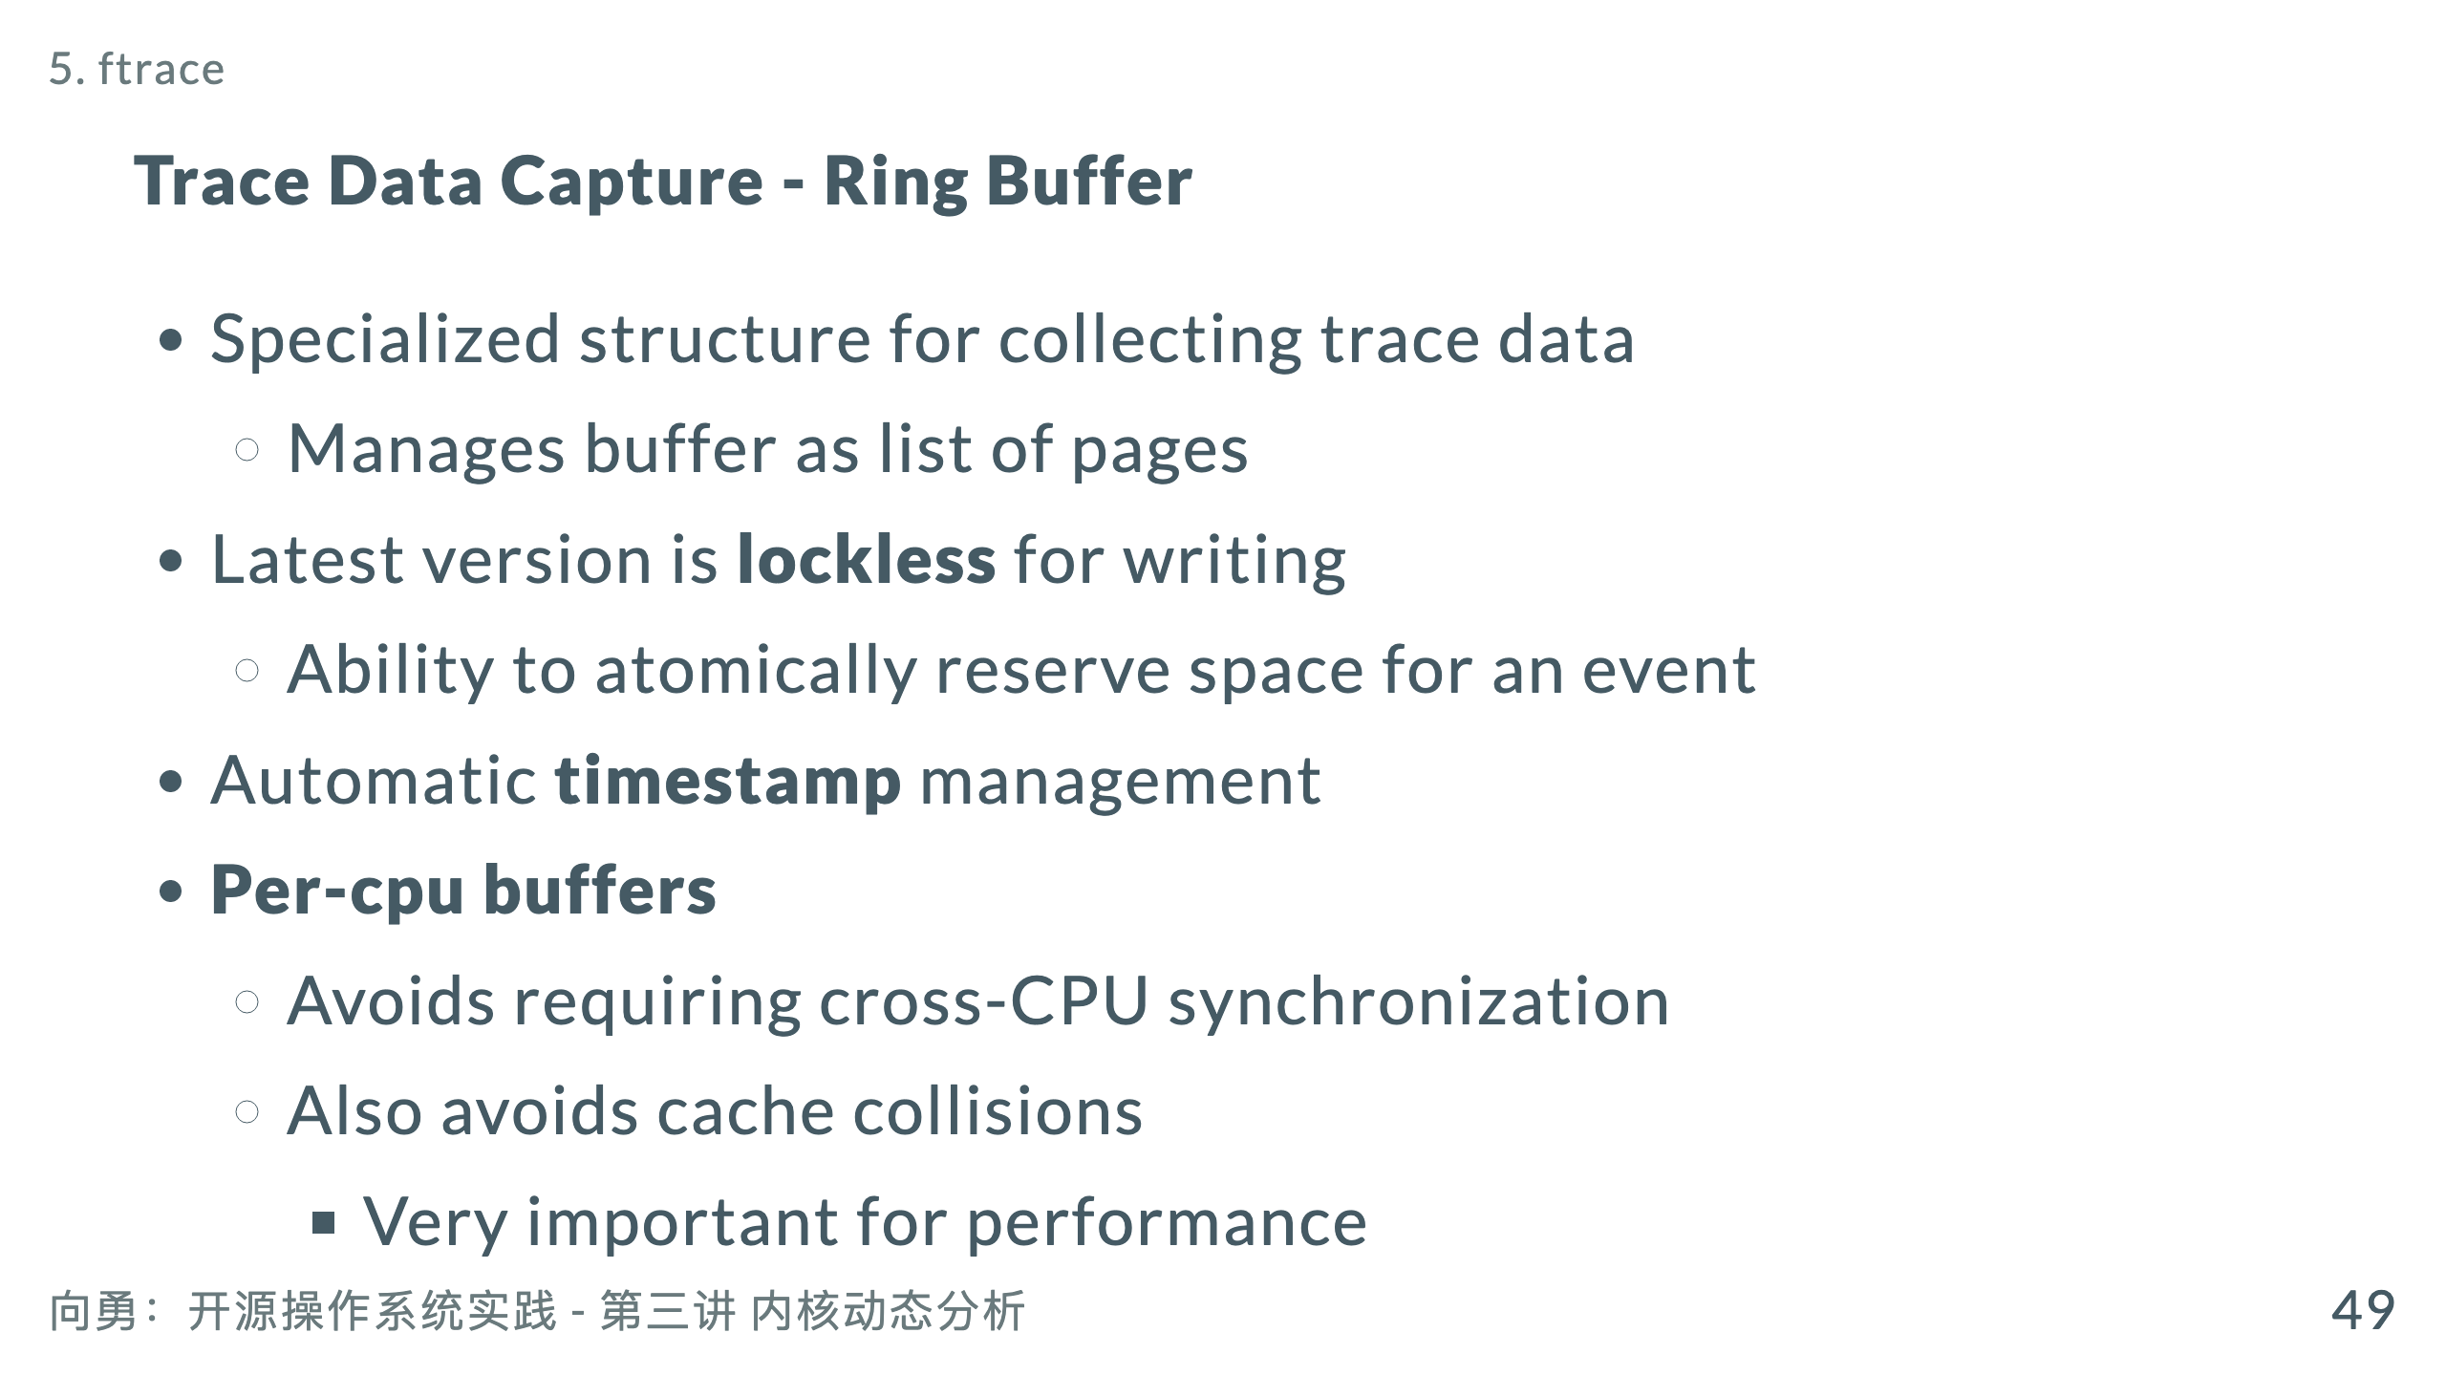

Slide 51
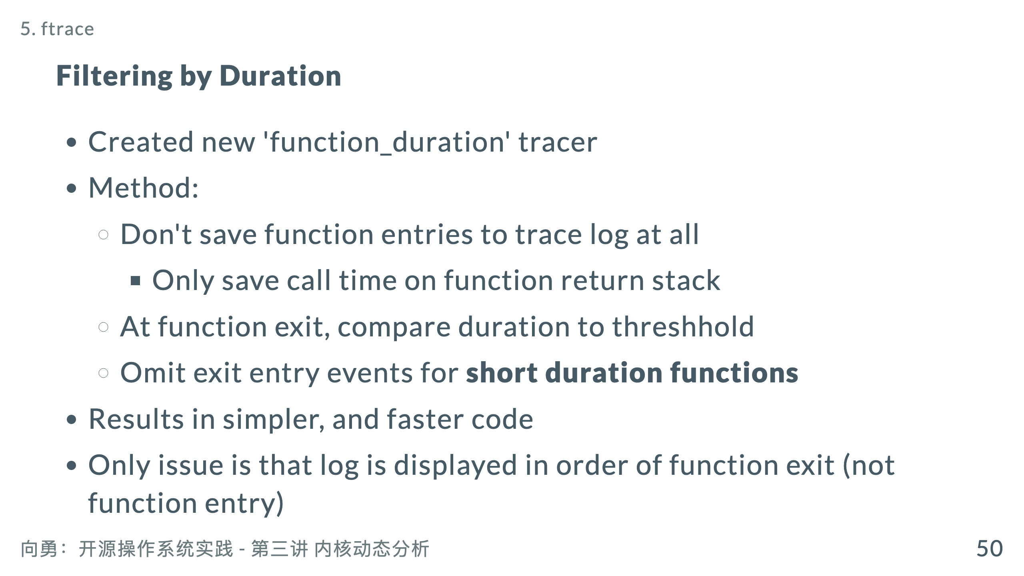
Notes:
* Can be solved with a simple sort on trace output

Slide 52
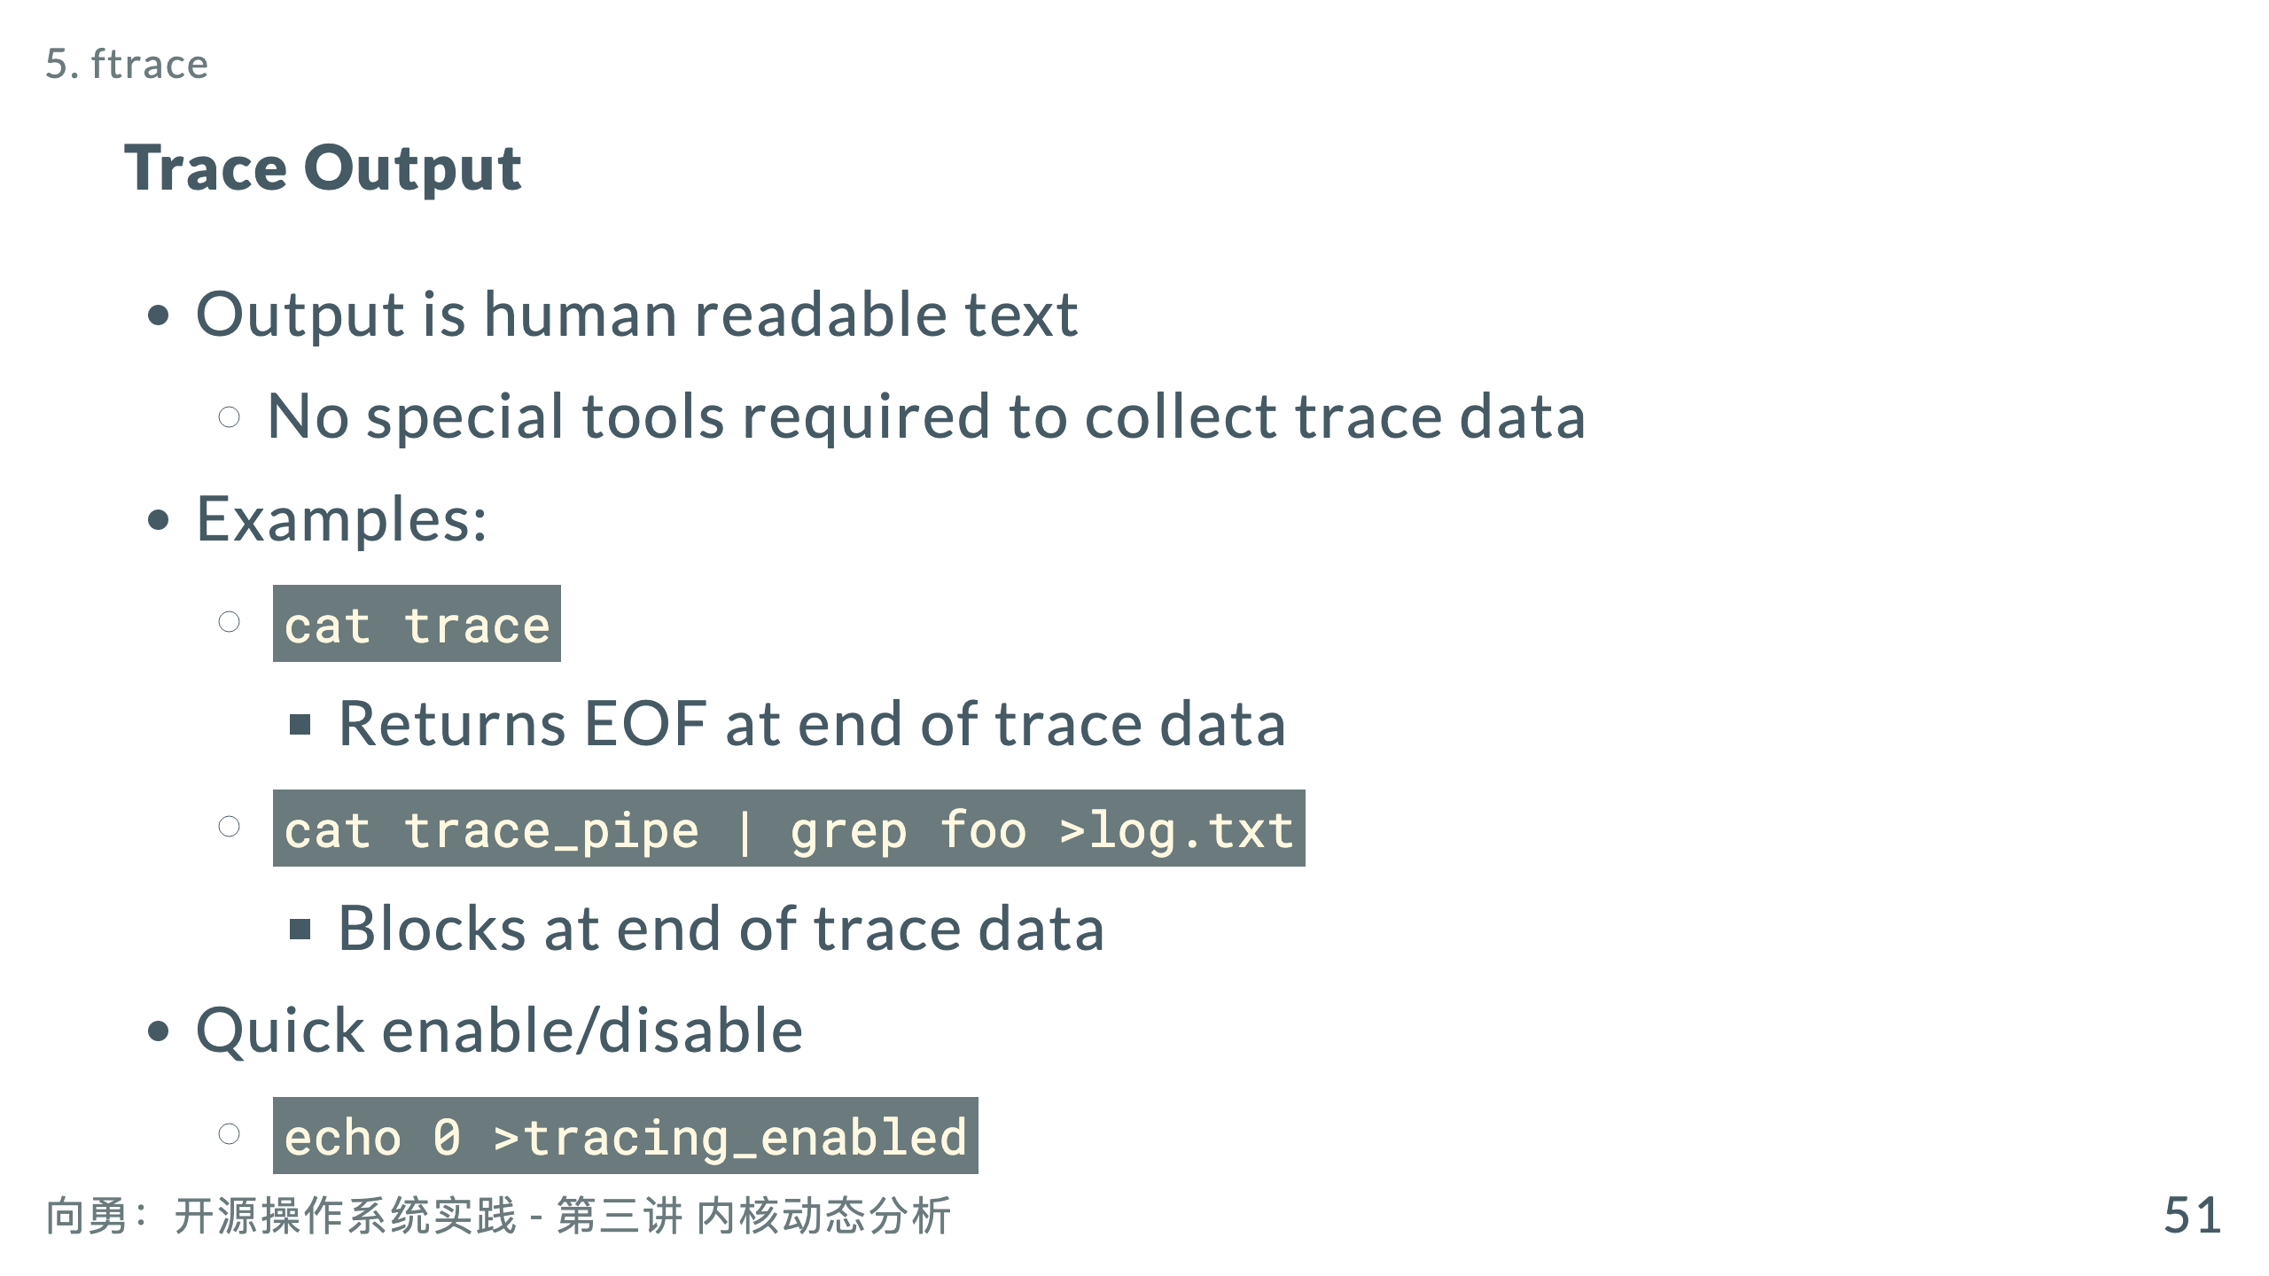

Slide 53


Slide 54

Notes:
0) sed-562 | 502.854993893 | ! 470.000 us | get_arg_page 0) sed-562 | 502.854997226 | ! 455.500 us | get_user_pages 0) sed-562 | 502.855000059 | ! 421.667 us | __get_user_pages 0) sed-562 | 502.855031393 | ! 285.666 us | handle_mm_fault 0) sed-562 | 502.855037726 | ! 101.833 us | __pte_alloc

Slide 55

Notes:
* Notes: * Total time may be wrong if process is scheduled out or if a filter was active * May need an option to subtract time that function was scheduled out * You can filter, sort, select output columns,etc.

Slide 56

Notes:
call_transmit 100 785408085 7854080 5871339 __nfs_revalidate_inode 38 696216223 18321479 1652173 nfs_proc_getattr 38 690552053 18172422 1234634

Slide 57


Slide 58


Slide 59


Slide 60

Notes:
为什么只有3~5分钟： Ftrace影响了网络输出速度，不能充分使用网络带宽 当缓冲区满后，即停止ftrace运行（不停止的话会产生数据丢失） Ftrace停止后，剩余数据继续输出

Slide 61


Slide 62


Slide 63

Notes:
##### QEMU Overview * Created by Fabrice Bellard in 2003 * Function-level emulation * Faster than “cycle-accurate” simulators. * Good enough to use applications written for another CPU. * Just-in-time (JIT) compilation support to achieve high performance * Lots of peripherals support (VGA, serial, and Ethernet, etc…) * Lots of target hosts and targets support (full system emulation) * Good enough to use applications written for another CPU. * User mode emulation: can run applications for another CPU. * Lots of target hosts and targets support (full system emulation) * x86, arm, mips, sh4, cris, sparc, powerpc, nds32, … * qemu/hw/* contain all of the supported boards. --- http://infoscience.epfl.ch/record/163071/files/s2e.pdf S2E: A Platform for In-Vivo Multi-Path Analysis of Software Systems ACM SIGARCH Computer Architecture News - ASPLOS '11 Volume 39 Issue 1, March 2011 Pages 265-278

Slide 64

Notes:
20130819-DCG-RTL.pptx

Slide 65


Slide 66


Slide 67

Notes:
http://www.openrce.org/blog/view/535/Branch_Tracing_with_Intel_MSR_Registers Some time ago I was flipping through the IA-32 Intel Architecture Softwre Developer's Manual Volume 3 when I came across the following information in section 15.5 (page 515, specific to the provided link)

Slide 68


Slide 69


Slide 70

Notes:
https://gitee.com/oscomp/seminar16-20210808/blob/main/README.md#2021操作系统大赛决赛阶段第三次技术报告和交流

Slide 71

Notes:
head_first_bpf_v4.pdf eBPF 技术简介 狄卫华 2022.5.20

Slide 72

Notes:
https://www.brendangregg.com/Slides/BSidesSF2017_BPF_security_monitoring.pdf

Slide 73


Slide 74


Slide 75


Slide 76


Slide 77


Slide 78

Notes:
##### 问卷 我们在这次课中讲解了7种内核动态跟踪方法。请以选择填写（多选）的方式回答各种方法所具体的特征。 gprof DTrace SystemTap ftrace S2E Vmxice eBPF 可能特征 探针注入方式：静态编译、动态代码注入、硬件支持、模拟器 数据采集准确性：周期采集、精确事件触发、 数据过滤方式：不过滤、内核可加载模块、虚拟机、 ---

Slide 79


Slide 80


Slide 81


